Slide 1
Physical Therapy Moves Me!
Grade 6-8 Presentation
Notes:
Things to Think About:
When speaking with this age group (sixth to eighth graders) the goal is to light a spark in their minds about the profession of physical therapy and get them thinking about what it would be like to be a physical therapist or physical therapist assistant. This presentation will focus less on the specifics of the profession and more on the high-level aspect of physical therapy, what PTs and PTAs do, and how they help people and bring value to the world.
When possible, try to relate what you are talking about back to your audience to help them connect with it personally. A great way to do this is by asking questions. For example: “Have your or anyone in your family ever seen a physical therapist?” “Have you ever fallen and hurt yourself and could not move like you wanted to?”
If you are using the Grade 6-8 PowerPoint along with these talking points you will see the slides that depicts the body systems of children and instructions that ask them to think about their movement. Think of it as trying to get them to learn while moving and having fun, engaged learning.

Slide 2
Notes:
Welcome.
Introduce yourself and give the reason for your presentation.
Explain what you hope to achieve by the end of the presentation For example: “By the end of this presentation I want you have a better understanding of how PTs and PTAs help people move.”

Slide 3
Notes:
Here Dani talks about how we are all healthier and happier when we move and how working with her physical therapist after her accident helped changed her life for the better.
This slide is a visual aid to help the audience see how physical therapy can have a positive impact on people’s lives. This age group is usually very visual, so hopefully it will help them connect to the rest of the presentation.
If you want to find another video, visit ChoosePT’s YouTube Page. If you are a PT Moves Me Ambassador, you can find videos on the PT Moves Me Ambassador Hub Community under the Recruitment Resources File Library.

Slide 4
What are some things you do that require movement?
Notes:
Start with a conversation to engage your audience and get them thinking about movement.
Try to get them to think beyond the obvious of walking, running, etc., to activities such as breathing, heart beating, swallowing, writing, chewing, etc. This will help them understand that movement involves multiple systems of the body, and PTs and PTAs treat and/or work with all those systems.
Help your audience to understand how essential movement is to life.

Slide 5
It’s estimated that
42 million people suffer from some form of movement loss in the United States.
Notes:
You just had a conversation about things we commonly do that require movement. Now tie that into the fact that there are people who do not move as freely and need assistance.
The purpose of this is to get them thinking about how many people in the country and the world are not able to move as freely or need assistance moving.
Movement is essential to life, and that’s why the profession of physical therapy is so important and why PTs and PTAs provided a valuable service to society.
Source: https://www.uofmhealth.org/conditions-treatments/brain-neurological-conditions/movement-disorders.

Slide 6
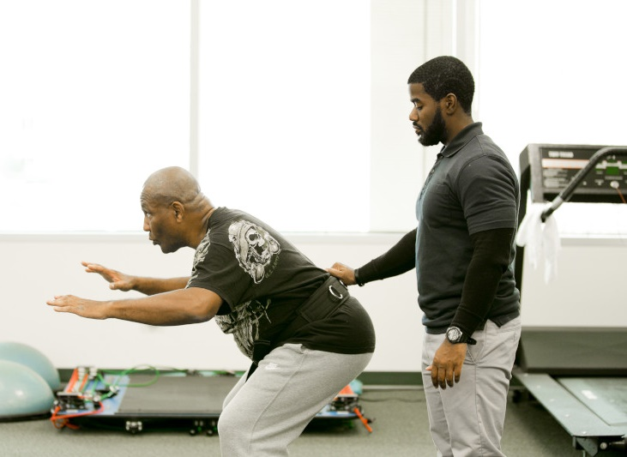
Physical Therapists Are Doctors Who Are Movement Experts
They prevent movement loss.
They restore and create movement.
They help relieve pain.
Notes:
Physical therapist are doctors who are movement experts and help people move.
They help people who:
Are not able to move as freely or who have lost the ability to move.
Are trying to maintain their movement function and prevent movement loss and function.
Here you can ask if anyone has seen a physical therapist or gone with a family member to see a physical therapist.
Emphasize again that movement is an essential part of life, and physical therapists and physical therapist assistants play a key role in keeping patients healthy through movement and increasing their patients’ quality of life.

Slide 7
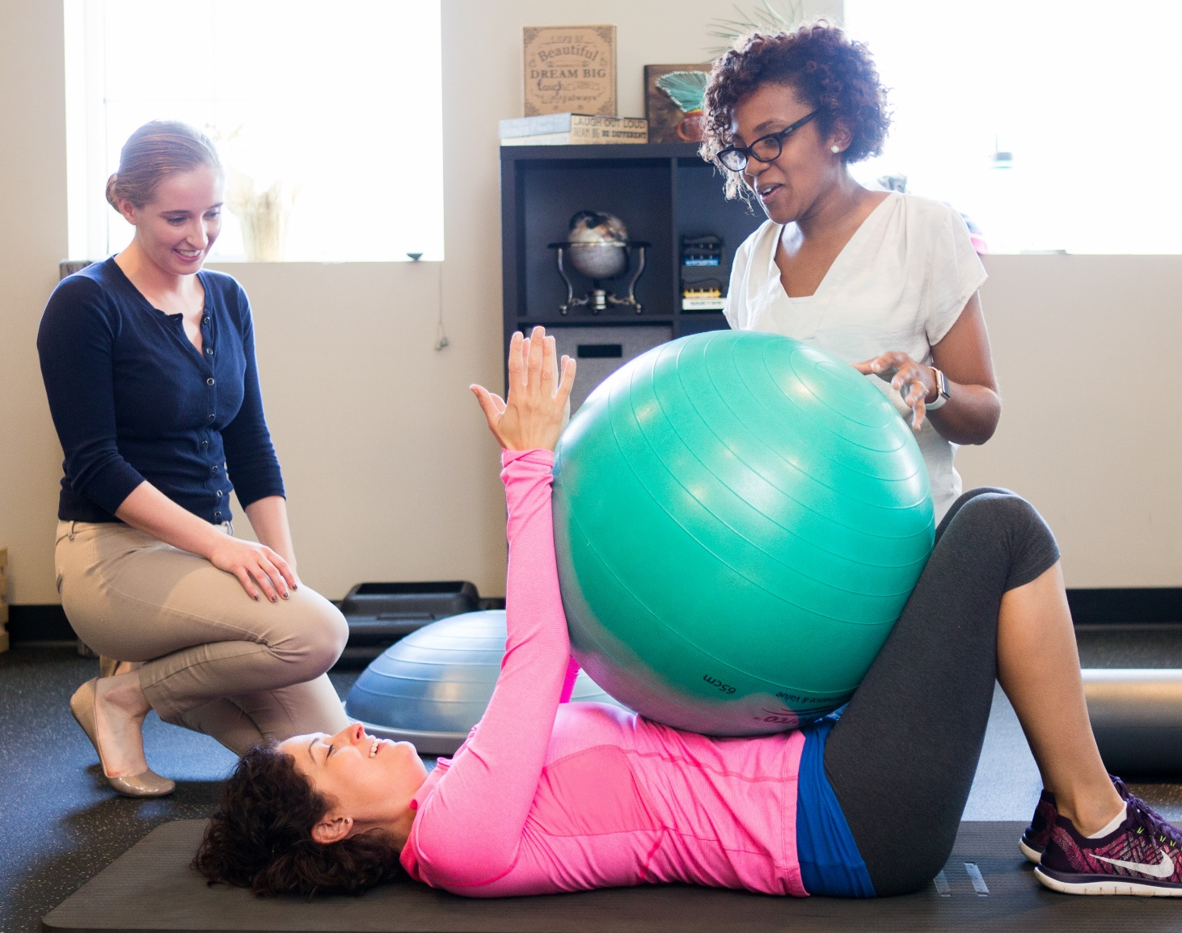
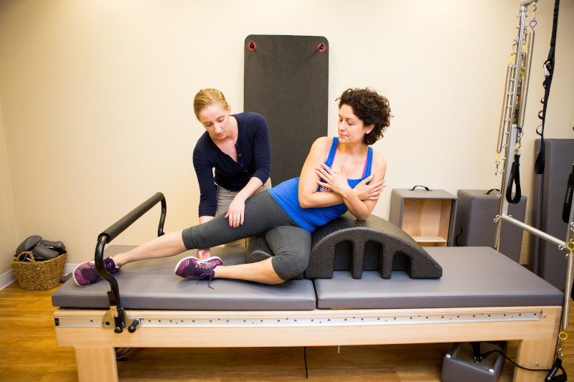
Physical Therapist Assistants Work With Physical Therapists
Physical Therapist Assistants
Help physical therapists implement patient treatment plans.
Notes:
There are two career pathways in the profession of physical therapy:
Obtain a doctor of physical therapy degree and become a licensed physical therapist.
Obtain an associate degree and become a physical therapist assistant.
Physical therapists are doctors who treat patients with movement dysfunction.
Physical therapist assistants work under the supervision of physical therapists and assist with implementing patient treatment plans.

Slide 8
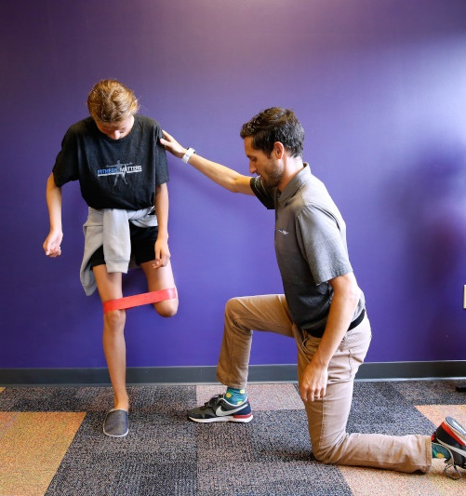
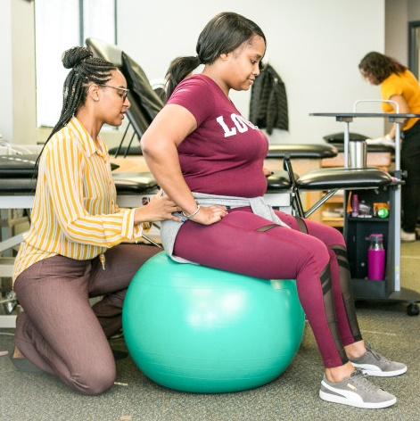
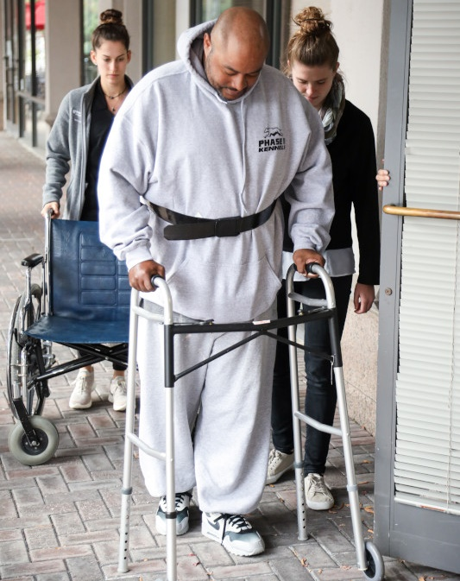
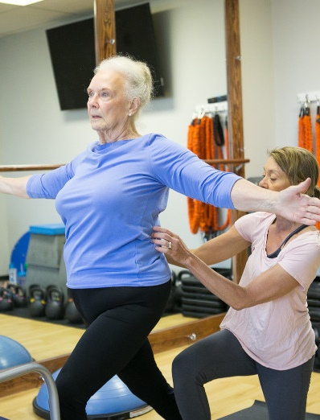
PTs and PTAs Care for People of All Ages and Abilities
They treat patients across the lifespan (birth to end of life)
Younger
Older
Notes:
We all need to move. From the moment we enter the world (even before), until the moment we leave. Movement is essential to life.
PTs and PTAs work with patients from all populations, young and old and all in between.
Depending on your audience, if you want to provide more detail, you can include the information below:
PTs and PTAs treat athletes and those who recently had a surgery, but they also treat:
Chronic conditions such as cystic fibrosis, cerebral palsy, and multiple sclerosis.
Those with autism, traumatic brain injury, and dementia.
Those with heart disease, with COPD, and recovering from COVID-19.
Those with chronic headaches, balance disorders, and musculoskeletal pain.
Physical therapy even helps after having a baby, having or recovering from cancer, and experiencing burns and wounds.
Almost any place you find health care providers, you’ll find a physical therapist or physical therapist assistant (hospital, outpatient clinic, assisted living facility, school, corporate workspace, health and wellness facility, etc.).

Slide 9
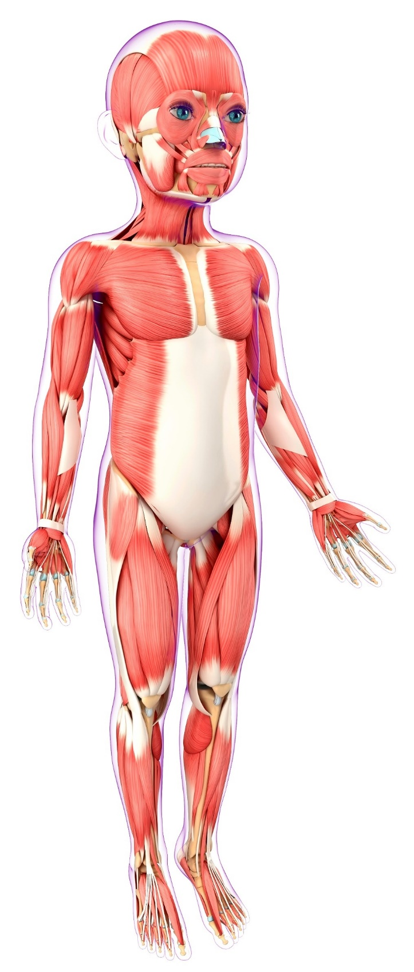
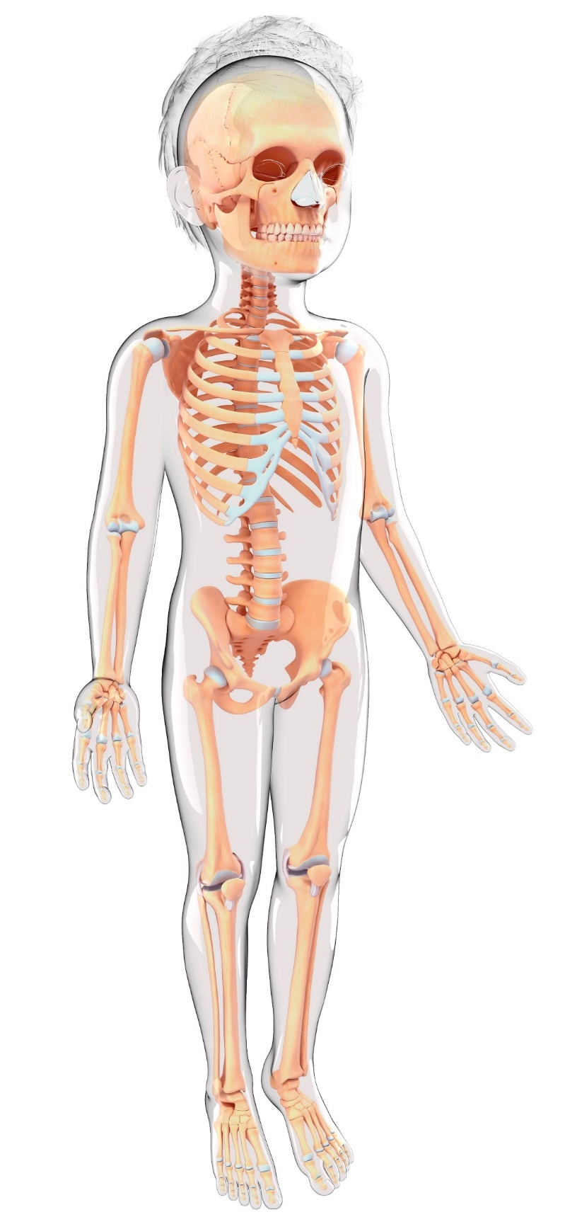
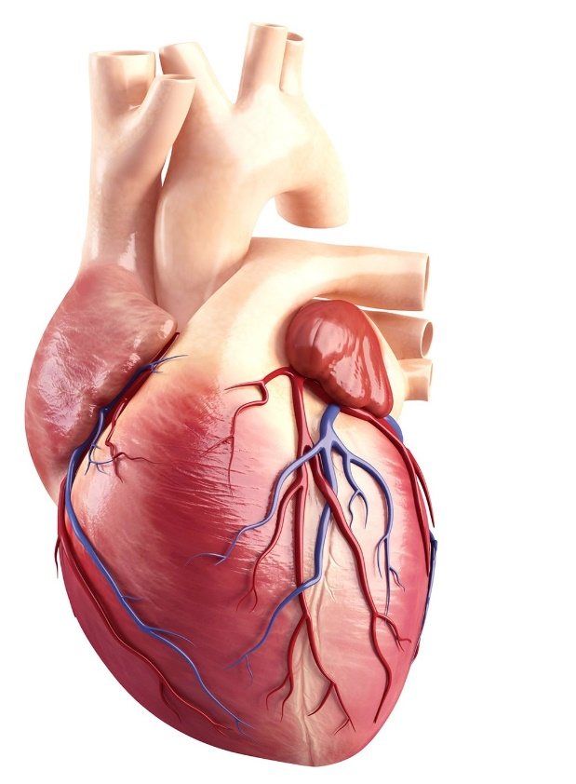
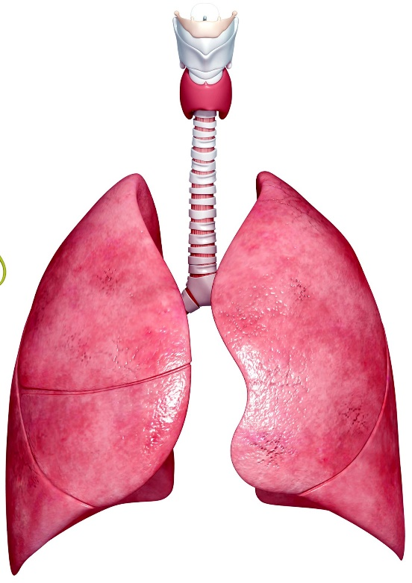
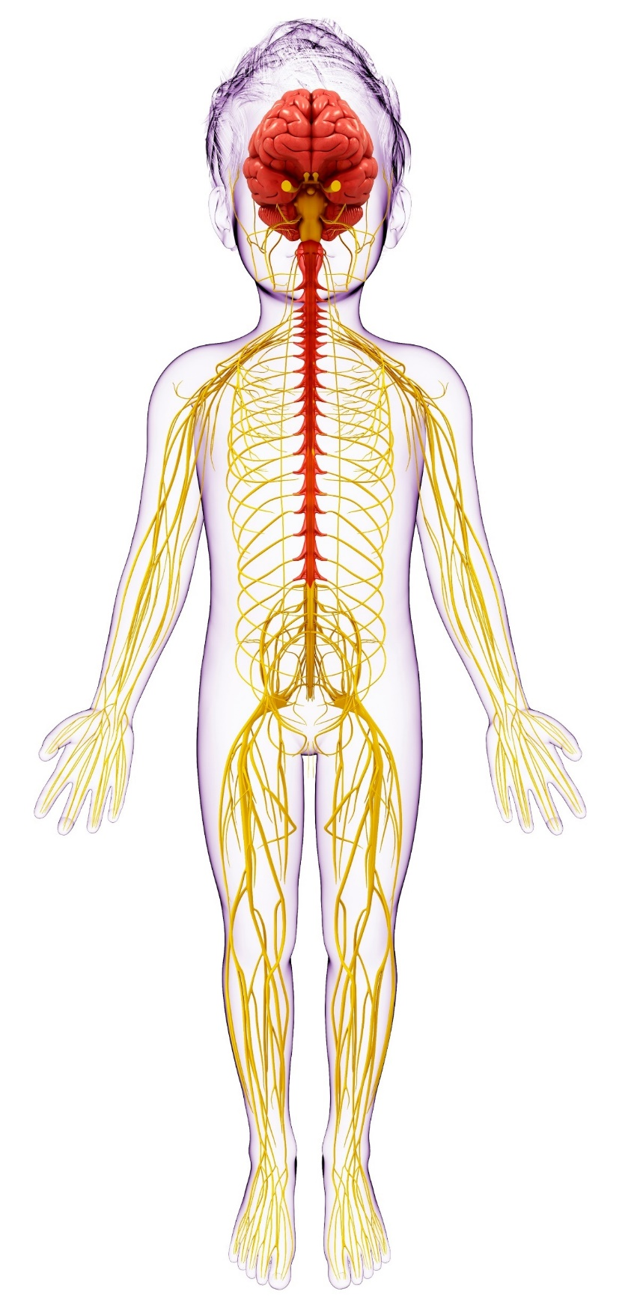
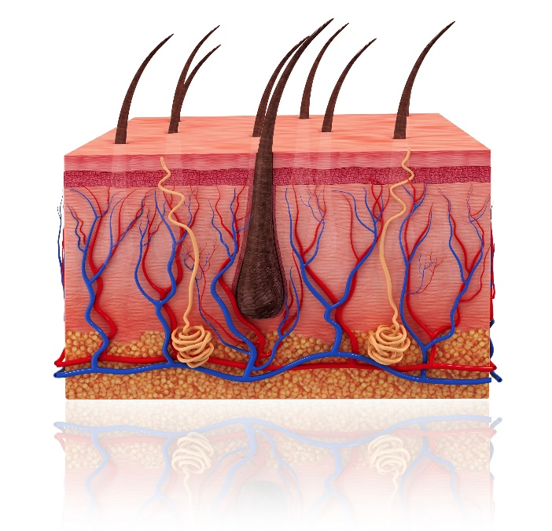
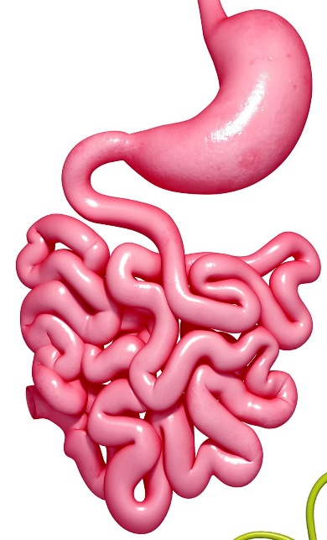
What Body Systems Are Involved in Movement?
Muscular
Skeletal
Cardiovascular
Respiratory
Nervous
Integumentary
Digestive
Notes:
The systems of the body are skeletal, muscular, nervous, endocrine, cardiovascular, lymphatic, respiratory, digestive, urinary, integumentary, and reproductive.
When you think about movement, which body systems do you think involve movement?
You need the muscular, skeletal, and nervous systems to move. Muscles attach to bones and the brain sends signals to your muscles through nerves telling your muscles to move.
However, movement takes place in other body systems as well:
Cardiovascular: Your heart is a muscle that pumps blood through your body.
Respiratory: Your lungs include your diaphragm, which is a muscle that allows you to breath.
Digestive: Your digestive system moves and contracts to enable you chew, swallow, and digest food.
Integumentary: Your skin moves and shifts with your muscles and bones.
And more.
Most of your body systems involve movement, and physical therapists work with all body systems. Some physical therapists even specialize in certain areas such as cardiopulmonary, neurology, electrical stimulation, and wound and burn management.

Slide 10
Who Can Benefit From Physical Therapy?
Anyone who moves … which means EVERYONE!
Muscle pain
COVID recovery
Chronic headaches
Balance issues
Heart disease
Lung disease
Traumatic Brain Injury
Sports
Cancer
Burns/wounds
Pregnancy
Autism
And more…
Notes:
Everyone!
If you move, you can benefit from seeing a physical therapist.
PTs help those with conditions and diseases such as:
Chronic pain such as back, knee, and shoulder pain.
COVID-19.
Heart or lung disease.
Cancer.
Balance issues.
Injury recovery.
And much more.

Slide 11
Physical Therapist Treatment
Notes:
Physical therapy is a very active profession. You will spend a lot of time with your patients and really get to know them. And you will move with your patients, which sometimes requires assistive devices, techniques, and creativity.
Here are a few treatment techniques used.

Slide 12
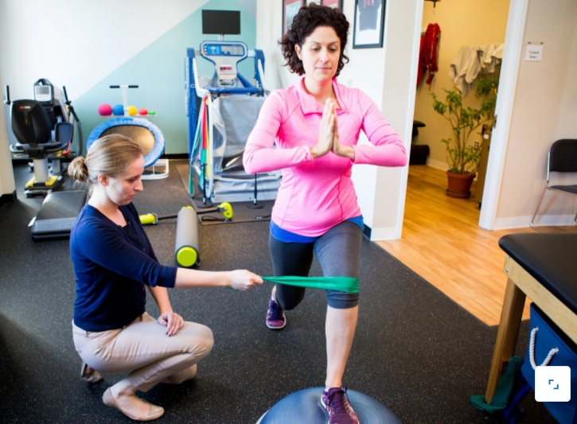
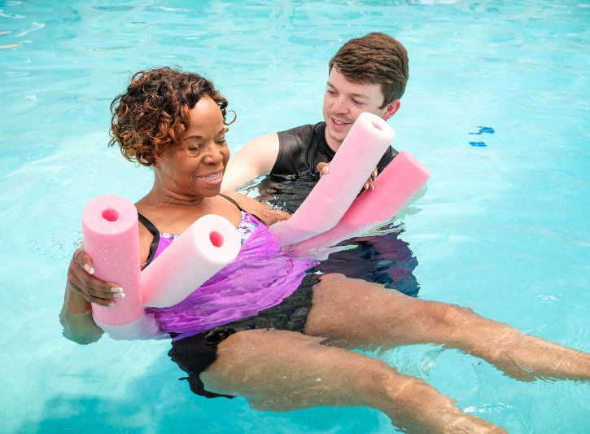
How Do PTs and PTAs Treat Patients?
Exercise Equipment
Pools
Notes:
Exercises using equipment and body weight, which teaches proper movement mechanics and strengthening muscles.
Pools or aquatic physical therapy, which helps decrease stress on the joints and muscles while providing resistance that helps with physical therapist treatment.

Slide 13
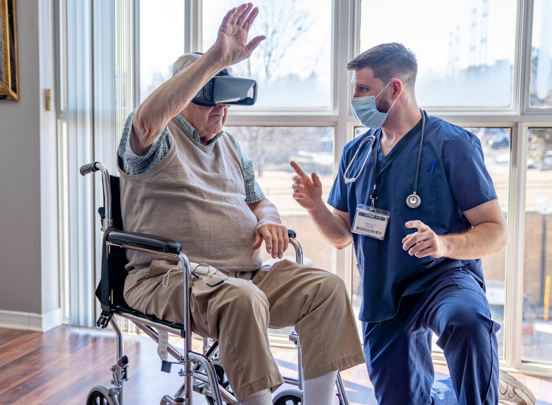
How Do PTs and PTAs Treat Patients?
Robotics and Virtual Reality
Toys and Games
Notes:
Toys and games, including video games, virtual reality, and robotic devices. When you are playing video games, playing with toys, and playing games you are moving! So, they can also be used to teach proper movement mechanics and help patients regain movement.

Slide 14
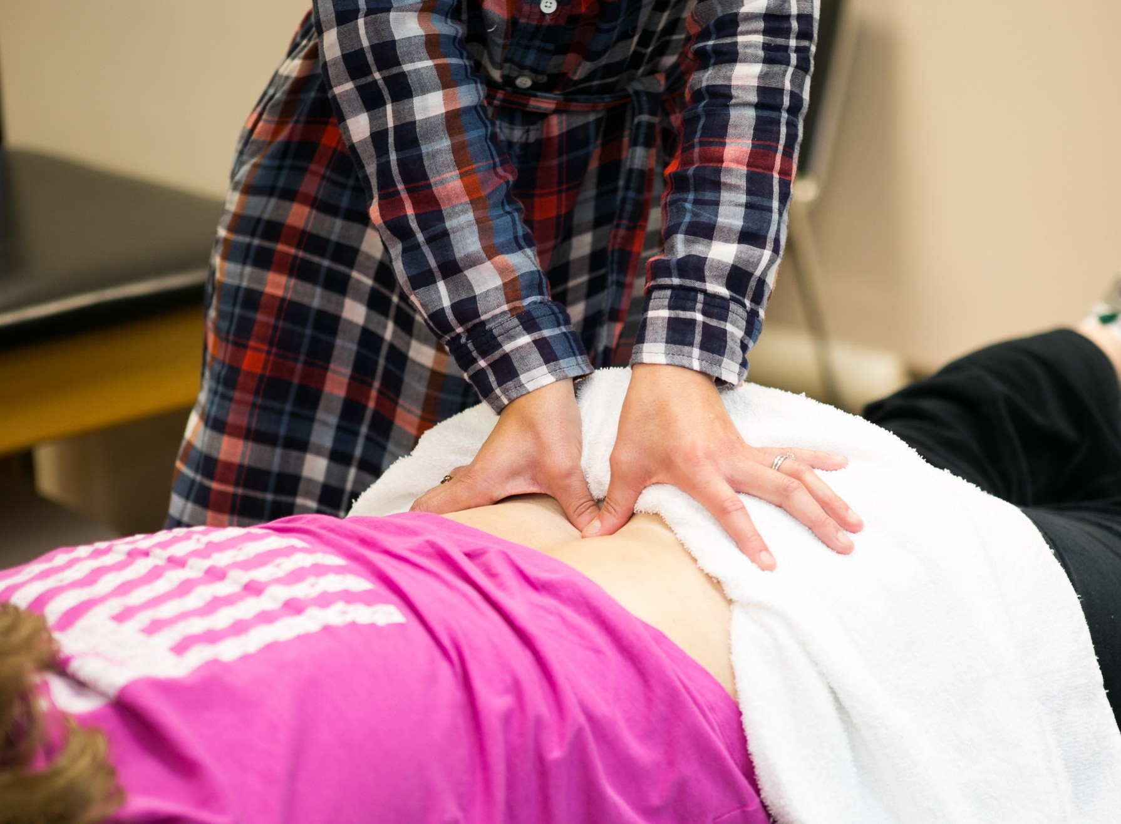
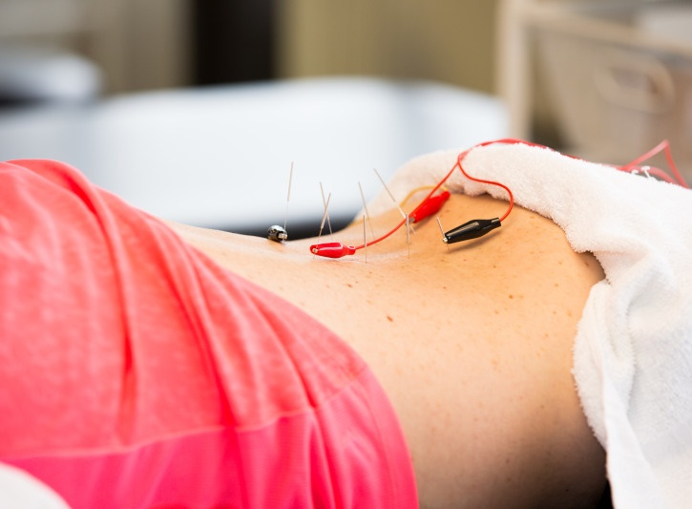
How Do PTs and PTAs Treat Patients?
Massage and Manual Therapy
Electrical Stimulation
Notes:
Manual therapy and electrical stimulation. PTs and PTAs are trained to locate muscles, joints, nerves, bones, and tendons through physical touch. PTs and PTAs can use massage, electrical stimulation, and other manual therapy techniques to treat patients.

Slide 15
How Do PTs and PTAs Treat Patients?
Range of Motion Measurement
Assistive Devices
Notes:
Goniometry and assistive devices. PTs and PTAs use goniometry to measure joint motion and range of motion. These measurements help determine patient treatment plans and more.
PTs and PTAs also teach patients how to properly use assistive devices to help with movement function.
These are just a few examples of how PTs and PTAs treat patients. There are many others.
Sometimes these and other treatments are used together to help patients move better.
If you are a PT, PTA, or student, this is a great place to include a personal story about how you had to be creative with treating a patient or something similar.

Slide 16
Time to Move!
Notes:
Lead some movement activities.
Since PTs and PTAs focus on movement, it is time to get up and get moving!
Choose from various activities. With these activities it is important to:
Explain the importance of each activity and how it is beneficial (functional movement, etc.).
Use your judgment on what is appropriate and safe depending on your audience and your environment. Safety first!
Be ready to provide modifications for those with physical limitations.
Examples of exercises and activities:
Stand up from the floor without using your hands.
Stand on one leg with your eyes closed.
Walk heel to toe with your eyes open and then with your eyes closed (partner exercise).
Perform a Y-reach.
Stretch.
Sit back-to-back on the floor and use your body weight to stand up (partner exercise).

Slide 17
Remember…
Physical therapy keeps people moving!
and
Movement is essential to life!
Notes:
After completing the movement activity, bring everyone back together.
Remind them that physical therapists and physical therapist assistants help keep people moving. If you have muscle pain, movement loss, or you just want to move better, see a physical therapist!
Recap some of the movements you did with the audience during this presentation. Emphasize how important it is to keep moving because movement is an important part of life. Physical therapists and physical therapist assistants are movement experts.

Slide 18
If You Like Being:
Active,
Creative, and
Helpful.
Consider a career as a physical therapist
or a
physical therapist assistant
Notes:
Call to a career in physical therapy!
If you like science, being active, talking to people, and being creative, then physical therapy might be a great career choice for you!

Slide 19
Notes:
Thank everyone for their time and listening.
Allow the audience to ask questions.
Option: Use handouts and age-appropriate activity sheets that can be found on the PT Moves Me Website (apta.org/PTMovesMe) or on the PT Moves Me Ambassador Hub Community if you are a PT Moves Me Ambassador. Flyers can also be emailed if this is a virtual presentation.
Option: Do another activity. See activity suggestions or come up with your own activity. Remember safety first.

Slide 20
Questions & Answers

Slide 21
Optional Slides to Add If Needed

Slide 22
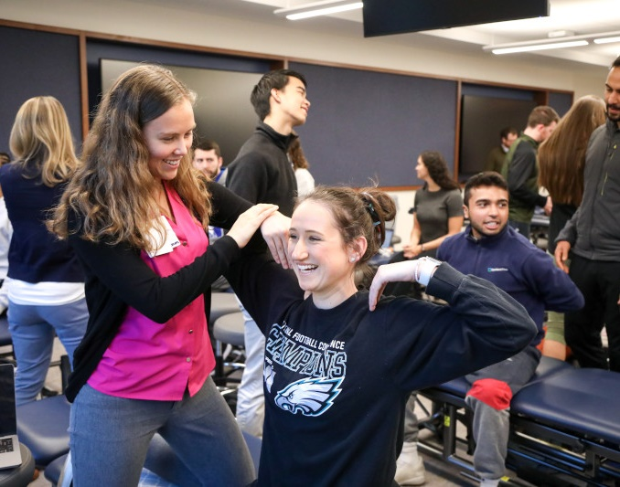
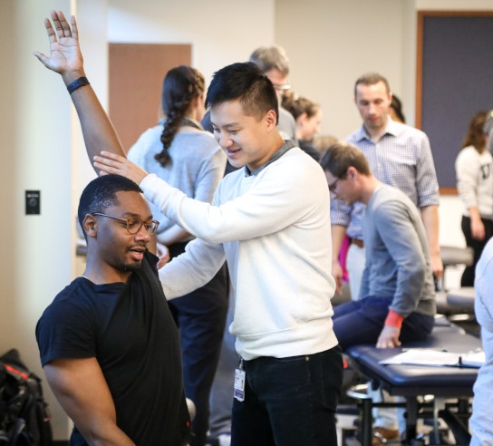
Pathway to DPT
High school diploma or GED
4-year Bachelor’s degree
3-year DPT degree*
PT licensure exam
PT
* Some DPT programs offer freshman entry
Notes:
To be a physical therapist, like most health professions, you will have to attend college and complete an undergraduate/bachelor’s degree, which takes about four years. Then you will need to earn a professional doctor of physical therapy graduate degree, which takes approximately three years.
The average salary for a physical therapist is about $89,000.

Slide 23
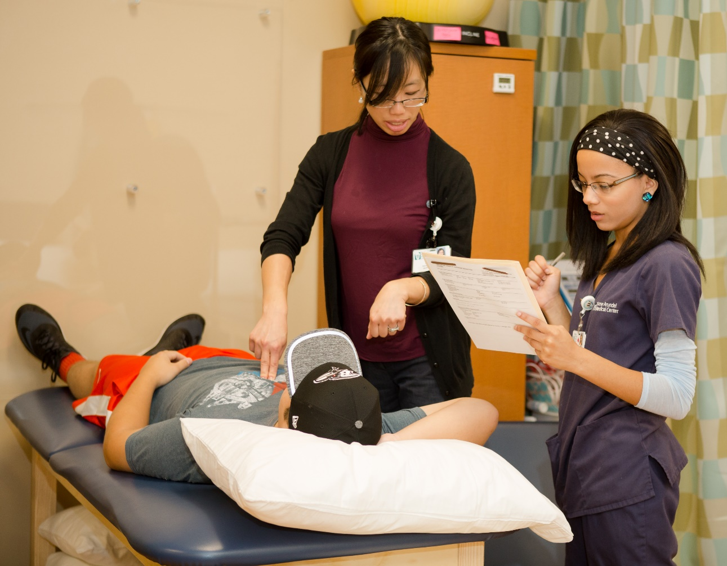
Pathway to PTA
High school diploma or GED
2-year associate degree
PTA licensure exam
PTA
Notes:
To be a physical therapist assistant, you will need to earn a two-year college associate degree after high school.
The average salary for a physical therapist assistant is about $58,200.

