Slide 1
The National Research Action Plan on Long COVID The landscape of Long COVID research activities in the United States
William Valiant, PhD
Fellow, Office of Long COVID Research and Practice

Slide 2
Overview
The National Research Action Plan on Long COVID (NRAP)
The seven research areas of the NRAP
Core Research Questions
Publications of note
US Government Research Initiatives
Gaps and future directions

Slide 3
Seven Research Areas of the NRAP
Characterizing the Full Clinical Spectrum of Long COVID and Diagnostic Strategies
Pathophysiology
Surveillance and Epidemiology
Long COVID and Overall Well-Being
Treatments and Other Health Interventions
Human Services and Supports
Health Services and Health Economics Research
The NRAP contains a brief synopsis of research, with descriptions of a small number of the principal research initiatives.
Research efforts can fit into multiple research areas
Each research area contains
Core Research Questions
Anticipated Impacts of Research
Health Equity Considerations

Slide 4
Research Area 1: Characterizing the Full Clinical Spectrum of Long COVID and Diagnostic Strategies
Core Research Questions
What is the clinical spectrum of recovery from acute SARS-CoV-2 infection and how does it change over time?
What are the clinical manifestations of Long COVID? Are there distinct subtypes (phenotypes) of Long COVID?
What is the natural history of Long COVID? How do the clinical manifestations of Long COVID vary across the lifespan and different demographic groups? How do they change over time? How are they affected by various interventions, such as vaccines?
Are there distinct phenotypes among those patients who do not fully recover or who develop new onset symptoms?
What are the biologic causes of Long COVID and how can they be reversed?
How does SARS-CoV-2 infection initiate or promote the pathogenesis of conditions or findings that evolve over time to cause organ dysfunction or increase the risk of developing other disorders?
What are the clinical criteria for diagnosing Long COVID?
What diagnostic tests and assays can be used to accurately and reliably diagnose Long COVID?

Slide 5
Development of a Definition of Postacute Sequelae of SARS-CoV-2 Infection
In a cohort study of over 9000 participants, a research tool was developed to identify patients with Long COVID.
12 symptoms were found to be significantly associated with Long COVID
Each of these symptoms were assigned a score
12 points was identified as the optimal threshold for Long COVID positivity
Thaweethai T, Jolley SE, Karlson EW, et al. Development of a Definition of Postacute Sequelae of SARS-CoV-2 Infection. JAMA. 2023;329(22):1934–1946. doi:10.1001/jama.2023.8823

Slide 6
Research Area 2: Pathophysiology
Core Research Questions
What are the pathophysiologic mechanisms of Long COVID?
What potential role do the following play in the development of Long COVID: immune dysregulation (including autoimmunity), persistent SARS-CoV-2 virus, reactivation of endogenous viruses, and organ injury during acute infection?

Slide 7
Distinguishing features of long COVID identified through immune profiling
In a cross-sectional study, the immune state of individuals with Long COVID was compared to controls.
Differences were detected in
Circulating immune populations
Anti-SARS-CoV-2 antibodies
Immune responses to herpesviruses

Slide 8
Research Area 3: Surveillance and Epidemiology
Core Research Questions
What are the population-level incidence and prevalence of Long COVID and associated conditions?
What are the population-level incidence and prevalence of activity limitation and disabilities associated with Long COVID and associated conditions?
What are the factors associated with incidence and prevalence of Long COVID?

Slide 9
Notes from the Field: Long COVID Prevalence Among Adults — United States, 2022
Using data from the 2022 Behavioral Risk Factor Surveillance System the prevalence of Long COVID was estimated.
The data included noninstitutionalized U.S. adults aged ≥18 years
The prevalence ranged from 1.9% in the U.S. Virgin Islands to 10.6% in West Virginia
Ford ND, Agedew A, Dalton AF, Singleton J, Perrine CG, Saydah S. Notes from the Field: Long COVID Prevalence Among Adults — United States, 2022. MMWR Morb Mortal Wkly Rep 2024;73:135–136. DOI: http://dx.doi.org/10.15585/mmwr.mm7306a4.

Slide 10
Research Area 4: Long COVID and Overall Well-Being
Core Research Questions
What are the impacts of Long COVID on
Health related quality of life
Employment, insurance, disability, and socioeconomic status
Educational and developmental outcomes
Caregivers and families

Slide 11
Assessment of Symptom, Disability, and Financial Trajectories in Patients Hospitalized for COVID-19 at 6 Months
In a cohort study of 825 adults discharged after COVID-19, symptoms, health, and quality of life were assessed.
Patients discharged after COVID-19 hospitalization experienced limited recovery in symptoms, functional status, and fatigue at 6 months.
56% of patients reported any financial problem 6-months post discharge
Admon AJ, Iwashyna TJ, Kamphuis LA, et al. Assessment of Symptom, Disability, and Financial Trajectories in Patients Hospitalized for COVID-19 at 6 Months. JAMA Netw Open. 2023;6(2):e2255795. doi:10.1001/jamanetworkopen.2022.55795

Slide 12
Research Area 5: Therapeutics and Other Health Interventions
Core Research Questions
What treatments are safe and effective for persons diagnosed with Long COVID? For which persons are they effective?
Which treatments are ineffective or unsafe?
What strategies will effectively prevent Long COVID?

Slide 13
Association of Treatment With Nirmatrelvir and the Risk of Post-COVID-19 Condition
Electronic health records from the VA were analyzed to understand the impact of Paxlovid treatment during acute COVID-19 on later Long COVID.
Patients treated with Paxlovid were
Less likely to have symptoms associated with Long COVID.
Less likely to be hospitalized.
Less likely to die.
Further studies have found non-significant associations between Paxlovid and the rate of Long COVID.
Rate of Post COVID Conditions
Xie Y, Choi T, Al-Aly Z. Association of Treatment With Nirmatrelvir and the Risk of Post–COVID-19 Condition. JAMA Intern Med. 2023;183(6):554–564. doi:10.1001/jamainternmed.2023.0743

Slide 14
Research Area 6: Human Services, Supports, and Interventions
Core Research Questions
What are the human services and supports needs of individuals with Long COVID?
What are the service delivery gaps or barriers for individuals with Long COVID in existing human services?
What interventions can be adapted or created to meet the needs of individuals with Long COVID to promote their full participation in society?

Slide 15
Addressing the Long-Term Effects of the COVID-19 Pandemic on Children and Families
In partnership with the social security administration, the National Academies of Science, Engineering and Medicine released a report on the Long-Term Effects of COVID-19.
What was learned during the pandemic that informs approaches to policies and programs, including those affecting early childhood care and education, that are necessary to address the developmental, emotional, behavioral, and physical health needs of children in “high-risk” communities to promote child health and well-being in the long-term?
What was learned during the pandemic about promising practices to support parent and caregiver well-being?
What policies (e.g., child care, health care) and practices can work to address disparities and inequities experienced by communities of color following a pandemic?

Slide 16
Research Area 7: Health Services and Health Economics Research
Core Research Questions
What is the current level of access to care for persons with Long COVID?
What are the barriers to care for persons with Long COVID?
How can the quality of care for persons with Long COVID be improved?
What are the best models of care for Long COVID, and how can those models be more widely adopted?
How do we leverage primary care to diagnose and manage the care of people with Long COVID in collaborative care models that provide effective access to needed specialty services?
What are the impacts of Long COVID on health care utilization?
What are the medical costs of Long COVID for individuals, families, communities, the health care system, states, and the nation?
How can we improve the financing of Long COVID care in the United States?
What are the broader economic impacts of Long COVID?

Slide 17
Direct Medical Costs Associated With Post–COVID-19 Conditions Among Privately Insured Children and Adults
Using a commercial insurance database, direct medical costs after COVID-19 were assessed.
Medical costs were significantly higher for both children and adults 1-, 3-, and 6-months post infection.
The increases were highest in adults 50-64.
Costs were higher among hospitalized cases compared with non-hospitalized cases.
Pike J, Kompaniyets L, Lindley MC, Saydah S, Miller G. Direct Medical Costs Associated With Post–COVID-19 Conditions Among Privately Insured Children and Adults. Prev Chronic Dis 2023;20:220292. DOI: http://dx.doi.org/10.5888/pcd20.220292

Slide 18
Long COVID Research at NIH: The RECOVER Initiative
RECOVER is conducting research to:
Understand clinical spectrum/biology underlying disease trajectory over time.
Define risk factors, numbers of people getting Long COVID, and if there are specific different types of Long COVID.
Study how Long COVID progresses over time and how that may relate to other illnesses.
Identify possible treatments for Long COVID.

Slide 19
RECOVER Announced Four Additional Clinical Trials Last Week
RECOVER-ENERGIZE is a clinical trial platform to investigate exhaustion or low energy that interferes with daily activities.
Two trials have been announced under ENERGIZE
Personalized cardiopulmonary rehabilitation for people who experience exercise intolerance
Structured pacing for people with post exertional malaise.

Slide 20
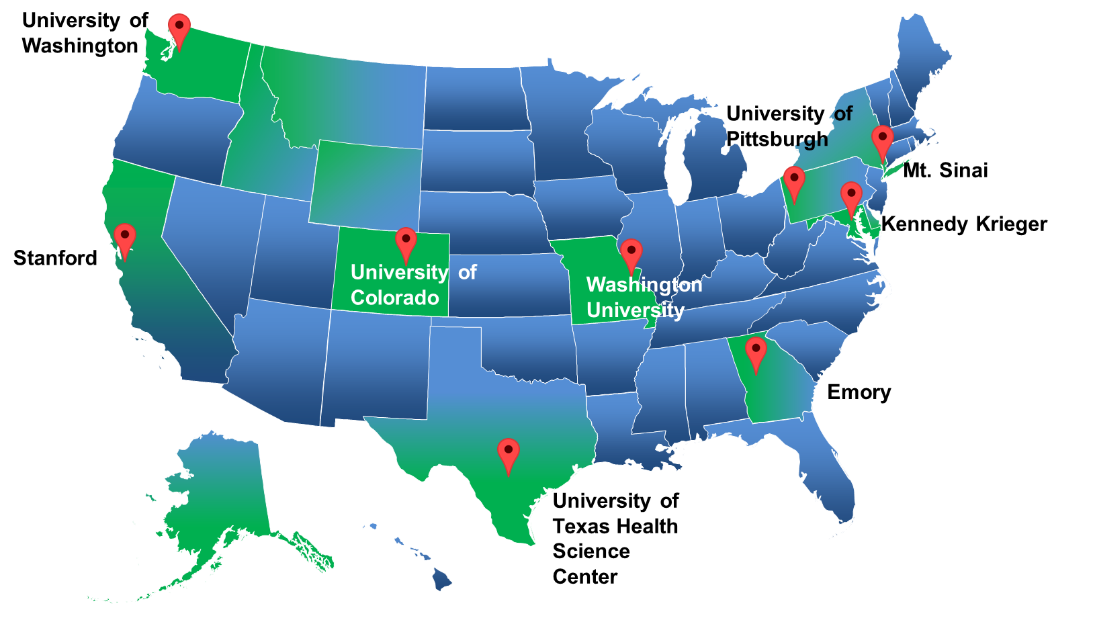
Agency for Healthcare Research and Quality (AHRQ) Long COVID Care Network
Notes:
The Agency for Healthcare Research and Quality (AHRQ), funded nine existing multidisciplinary Long COVID clinics across the country to expand access to comprehensive, coordinated, and person-centered care for people with Long COVID, particularly underserved, rural, vulnerable, and minority populations that are disproportionately impacted by the effects of Long COVID.
They are designed to:
expand access and care,
develop, and implement new or improved care delivery models,
foster best practices for Long COVID management,
support the primary care community in Long COVID education.

Slide 21
Involvement of the Private Sector
Clinical trials
Conducting Phase 1 and 2 clinical trials on novel compounds.
Support of federal clinical trials.
Support of electronic health record research
Use of proprietary tools to compile electronic health records from multiple institutions.
Development of multidisciplinary clinics in hospital systems.
Support of clinician education.
Providing care

Slide 22
Gaps and Future Directions
Models of Care
Delivery of Supports and Services
Childhood Development and Education
Economic and Financial

Slide 23
How would you prioritize these research areas as most impactful to least impactful to your work?

