Slide 1
Understanding Long COVID:
From epidemiology to clinical care
Pragna Patel, MD MPH DTM&H
Chief Medical Officer
Coronavirus and Other Respiratory Viruses Division
National Center for Immunizations and Respiratory Diseases
plp3@cdc.gov

Slide 2
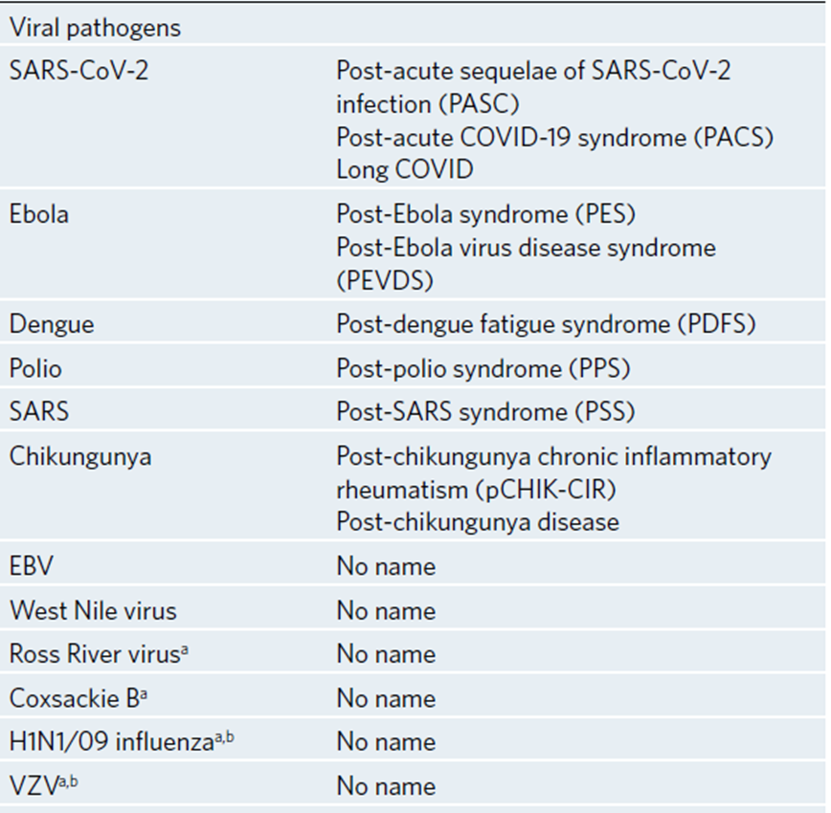
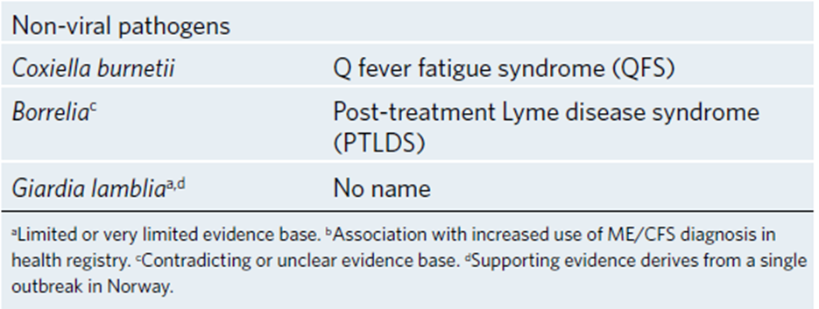
Many unexplained post-acute infection syndromes (PAIS) with many different pathogens
SARS- CoV-2 is not unique in its ability to cause post-acute sequelae
PAIS overlaps with myalgic encephalomyelitis/chronic fatigue syndrome (ME/CFS)
Potential for common etiology and pathogenesis
Choutka et al. Unexplained post-acute infection syndromes Nature Medicine 2022

Slide 3
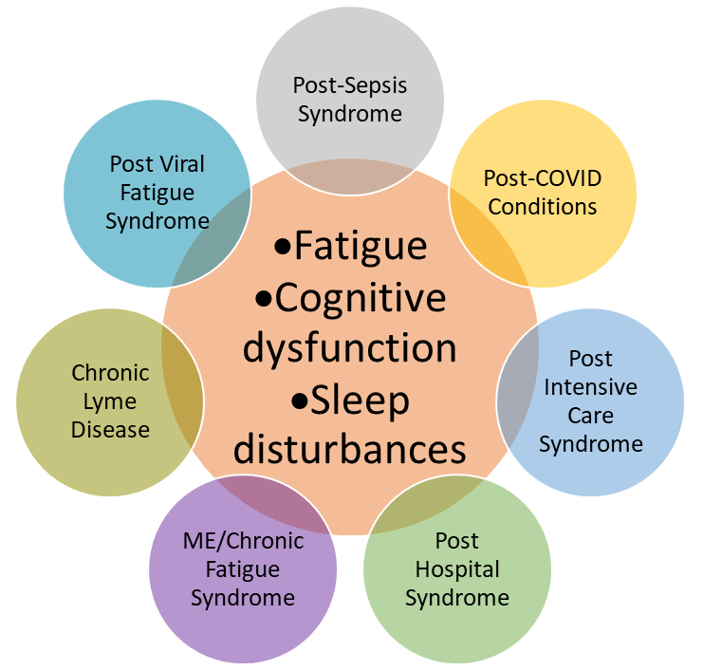
Unexplained post-acute infection syndromes (PAIS)
Recognized as “failure to recover” from wide variety of infections
Core symptoms
  Exertional intolerance (post-exertional malaise)
  Activity limitations due to disproportionate fatigue
  Neurocognitive problems
  Sleep problems
  Recurrent flu-like symptoms
Wide variety of additional symptoms may be present
  Some “trigger” specific
  Results in heterogeneous clinical picture
  Chronic complex illness requiring symptom management
Choutka J, Jansari V, Hornig M, Iwasaki A. Nat Med (2022) 28:911-923

Slide 4

Challenges shared by ME/CFS and PAIS
Diagnosis relies on symptom profile
  Temporal association with infection, if known
Requires medical history, physical examination and testing
  Identify treatable illnesses that could contribute to symptoms
Patients have difficulty finding health care providers that understand their illness
Chronic complex illnesses don’t fit into current clinical frameworks
No approved drugs for therapy
Clinical guidance at level of expert opinion

Slide 5

Integrated approach for ME/CFS and PAIS including Long COVID
Increase access to multi-disciplinary health care
  Empower primary care providers to diagnose and manage
  Establish clinics seeing full spectrum of PAIS and related overlapping conditions (postural orthostatic tachycardia syndrome, dysautonomia, mast cell activation syndrome, fibromyalgia, etc.)
Develop case definitions for clinical, research and surveillance applications
  Infection not always recognized or documented
Research to clarify mechanisms of disease
  Studies including ME/CFS, Long COVID and related syndromes as comparison groups

Slide 6
What is Long COVID?

Slide 7
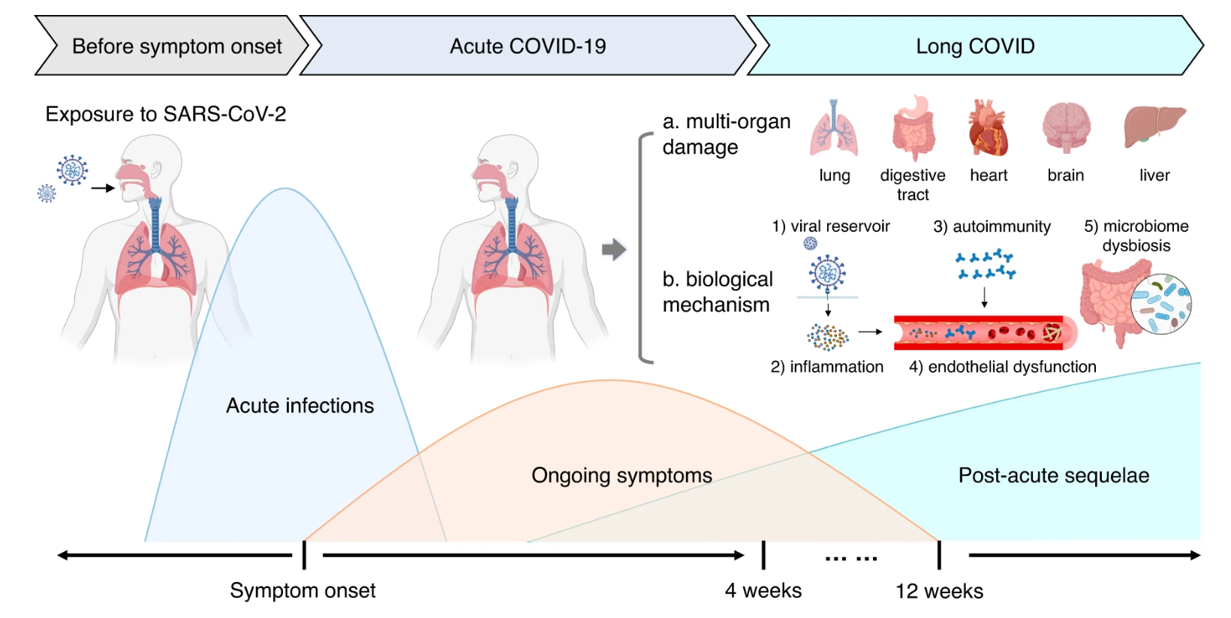
Timeline of Long COVID
Li et al. The long-term health outcomes, pathophysiological mechanisms and multidisciplinary management of long COVID. Signal Trans Tar Therapy 2023

Slide 8
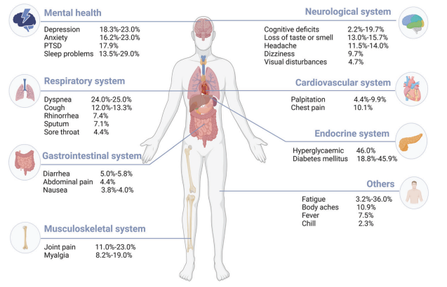
Symptoms
General symptoms
Tiredness /fatigue that interferes with daily life
“post-exertional malaise”
Cardiovascular and Respiratory symptoms
Dyspnea/shortness of breath
Cough
Chest pain
Heart palpitations
Digestive symptoms
Diarrhea
Stomach pain
Neurological symptoms
Difficulty thinking or concentrating ( “brain fog”)
Headache
Sleep problems
Depression or anxiety
Long COVID or Post-COVID Conditions | CDC

Slide 9
Framework terminology for conditions following
COVID-19
General Consequences of Illness and Hospitalization
General Consequences of Illness and Hospitalization
Post ICU-syndrome
Other complications of illness and treatment
Post-Acute Consequences of SARS-CoV-2 Infection
System-specific pathology (e.g., lung fibrosis, stroke)
Clinically significant symptoms with unclear pathology (e.g., ME/CFS*-like, dysautonomia)
Long COVID
These conditions frequently overlap, patients may experience any combination
* ME/CFS: Myalgic Encephalomyelitis/Chronic Fatigue Syndrome

Slide 10
Risk Factors for Long COVID and Burden

Slide 11
Risk Factors for Post-COVID Conditions
Female sex
Older age (sometimes)
  Adolescents compared to younger children
  Middle-aged adults compared to younger and older adults for symptoms
  Older adults compared to younger adults for incident conditions
Severity of COVID-19 illness
Reinfection
Underlying health conditions prior to COVID-19
Lower socio-economic status
Did not get COVID-19 vaccine
Maglietta G et al. Prognostic Factors for Post-COVID-19 Syndrome: A Systematic Review and Meta-Analysis. JCM 2022
Socioeconomic inequalities of Long COVID-UK. Shabnam et al. 2023 (sagepub.com)
Hastie. et al. Outcomes among confirmed cases and matched comparison group in the Long COVID in Scotland Study. Nature 2022
Epidemiology of Long Coronavirus Disease in US Adults | Clinical Infectious Diseases | Oxford Academic (oup.com)
Frontiers | Hospital admission and vaccination as predictive factors of long COVID-19 symptoms (frontiersin.org)
Prevalence and risk factors for persistent symptoms after COVID-19: a systematic review and meta-analysis – ScienceDirect
Acute and post-acute sequelae associated with SARS-CoV-2 reinfection

Slide 12
Prevalence of Long COVID
10.2% of U.S. adults who ever had COVID-19 currently report Long COVID
Differs by demographics
  Higher among females compared to males (12.7% v 7.4%)
  Lower among Non-Hispanic Asian (5.9%), compared to non-Hispanic White (10.8%), non-Hispanic Black (10.4%), and Hispanic (8.5%)
Data source: April 26-May 8, 2023 Long COVID - Household Pulse Survey - COVID-19 (cdc.gov)
Notes:
Internet survey representative of the non-institutionalized U.S. population
Report of symptoms lasting ≥3 months and not present prior to having COVID-19
Symptoms currently present – persons with COVID as denominator

Slide 13


Trends of Long COVID and significant activity limitations among adults- United States, June 1–13, 2022, to June 7–19, 2023
The prevalence of Long COVID (currently reporting symptoms lasting ≥ 3 months) among non-institutionalized adults:
Decreased from June 2022 to January 2023
Remained unchanged through June 2023
Almost 1 in 4 adults with Long COVID report significant activity limitations
Long COVID and Significant Activity Limitation Among Adults, by Age — United States, June 1–13, 2022, to June 7–19, 2023 | MMWR (cdc.gov)
Notes:
CDC and the US Census Bureau conducted an internet based survey of U.S. adults asking those who ever reported having COVID-19 if they had long COVID. Internet survey representative of the non-institutionalized U.S. population and uses the same questions as the National Health Interview Survey.
The percent reporting Long COVID has declined since June 2022- and remained steady since January 2023. However, approximately 1 in 4 adults who report having Long COVID that report significant activity limitations. This proportion has not has not changed in the past year.

Slide 14
Evidence of Disability Associated with Post-COVID Conditions
Post-COVID-19 Symptoms Were Worse Than Cancer’s Effect
Compared with patients referred for cancer rehabilitation, post-COVID patients had poorer physical health
  More difficulty doing usual work (37.2% versus 20.4%) or participating in activities with friends (33.0% versus 18.8%)
  Reduced endurance in 6-minute walk test (distance of 303 m versus 377m)
Ability to participate socially was significantly lower
Patient and advocacy groups’ reports have brought attention to disability associated with PCC and the importance of including patients and caregivers in related research
JAMA 2021: 326; 692; MMWR 2021; 70: 967-971

Slide 15
Long COVID and Associated Disability
Long COVID under Americans with Disabilities Act (ADA)
  Is a physical or mental impairment
  Can substantially limit one or more major life activities
  Not always a disability (must meet impairment criteria)
Extent and duration of disability associated with persistent symptoms is being studied
  Estimates: 2–4 million Americans are out of work due to Long COVID with annual cost of lost wages around $170 billion
  COVID-19 illnesses have reduced the U.S. labor force by ~500,000 people (0.2% of adults)
New data shows long Covid is keeping as many as 4 million people out of work (brookings.edu)w30435.pdf (nber.org)

Slide 16
Management of Long COVID

Slide 17

Clinical challenges with Post-COVID conditions
Complex clinical situation presents diagnostic challenges
  No single diagnostic test
Patient-reported symptoms are numerous
Symptoms and debilitation often not explained by objective tests
  Patients can be misunderstood and stigmatized
No clinical trial data or management outcomes available
Patients need multi-disciplinary care – several models of care
Characterizing long COVID in an international cohort: 7 months of symptoms and their impact

Slide 18
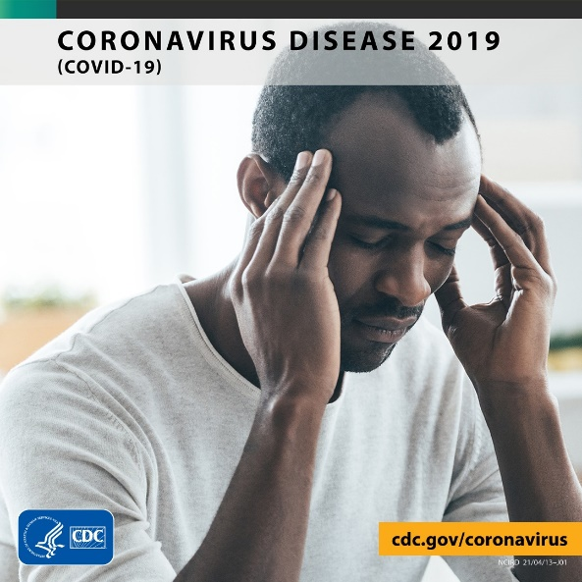
Information for healthcare providers on evaluating and caring for patients with Post-COVID conditions
Most post-COVID conditions can be diagnosed and managed by primary care
Many post-COVID conditions may be diagnosed based on history and physical exam, routine tests may be normal
Consider conservative diagnostic approach in the first 4 to 12 weeks
Symptoms persisting beyond three months should prompt further evaluation
Listen to and validate patients’ experiences and partner with patients to identify achievable health goals
Post-COVID Conditions: Information for Healthcare Providers (cdc.gov)
U.S. ICD-10 CM code for post-COVID conditions
(as of October 1, 2021)
U09.9 Post COVID-19 condition

Slide 19
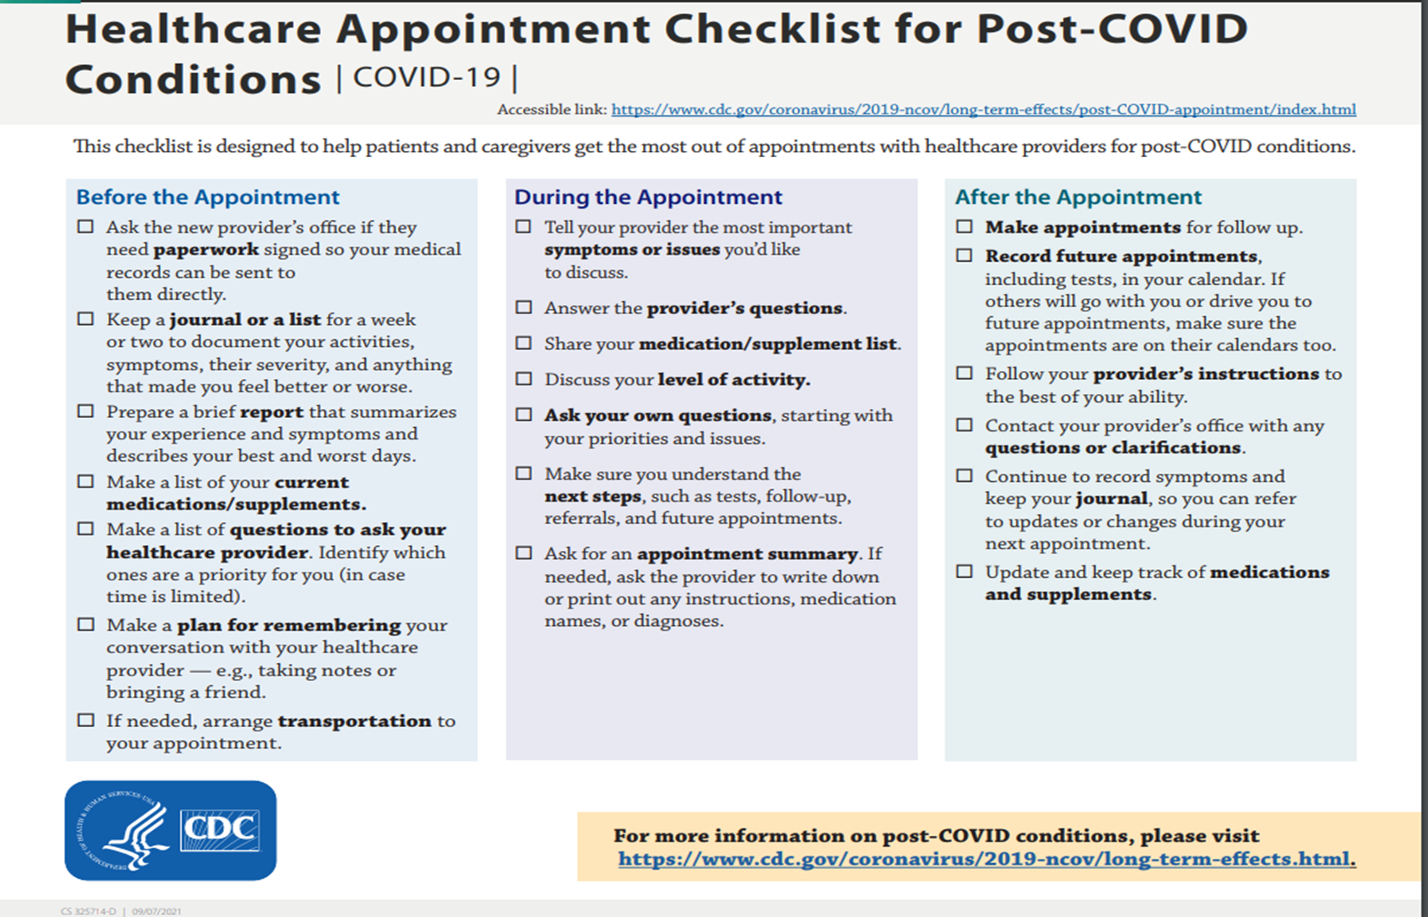

Slide 20
Healthcare Provider Appointments for Post-COVID Conditions
Listen to the patient’s story
Questions to ask:
  What is your activity level?
  What activities make your illness worse?
  What improves or worsens your symptoms?
Outline next steps:
  Additional tests needed
  Discuss potential services needed (e.g., physical therapy, etc.)
  When test results will be available
  When to return for next visit
https://www.cdc.gov/coronavirus/2019-ncov/long-term-effects/post-covid-appointment/index.html

Slide 21
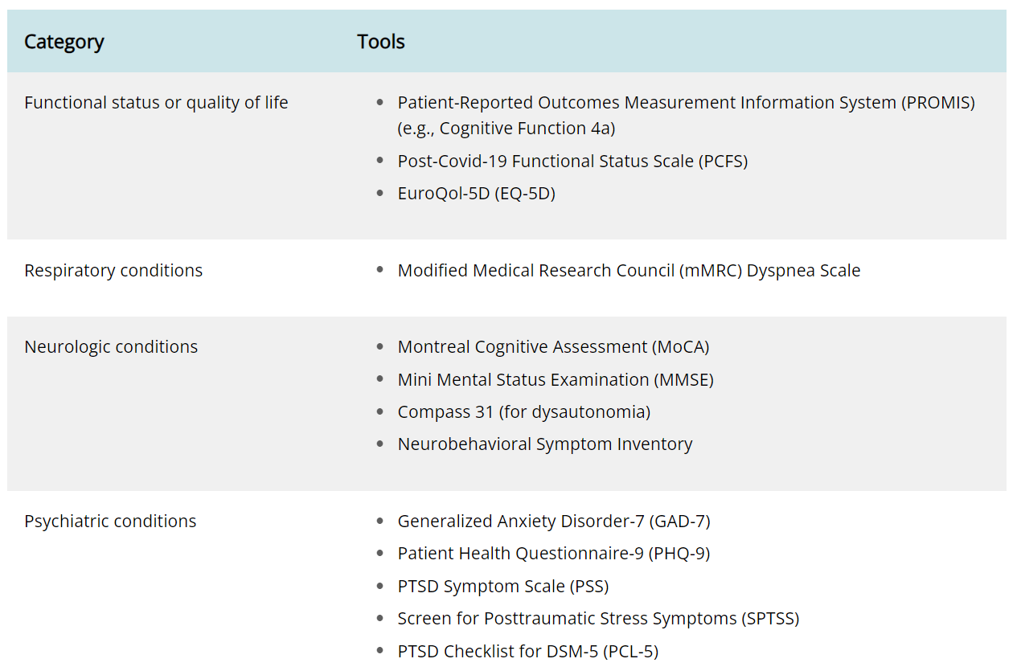
Recommended Assessment Tools
American Academy of Physical Medicine & Rehabilitation’s functional assessments

Slide 22
Management of Long COVID Symptoms
Based on experience with ME/CFS https://mecfscliniciancoalition.org/
Work with patients and their families to decide which symptom causes most problems
  Manage these first
  Nonpharmacologic approaches should be tried first
  Medications should be started at lowest possible doses
Ask questions to determine if post-exertional malaise (PEM) is present
  Address PEM with activity management or pacing
  Avoid over exertion causing flare-up of symptoms
  Individualized approach to find limits for physical and mental activity
  Vigorous aerobic exercise than may benefit people with other chronic illness is not tolerated and can cause significant harm

Slide 23
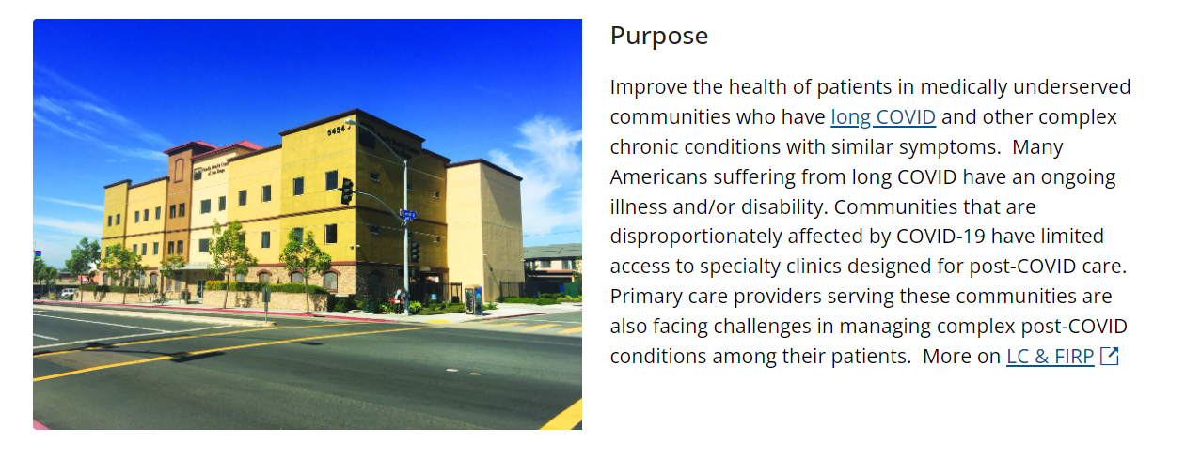

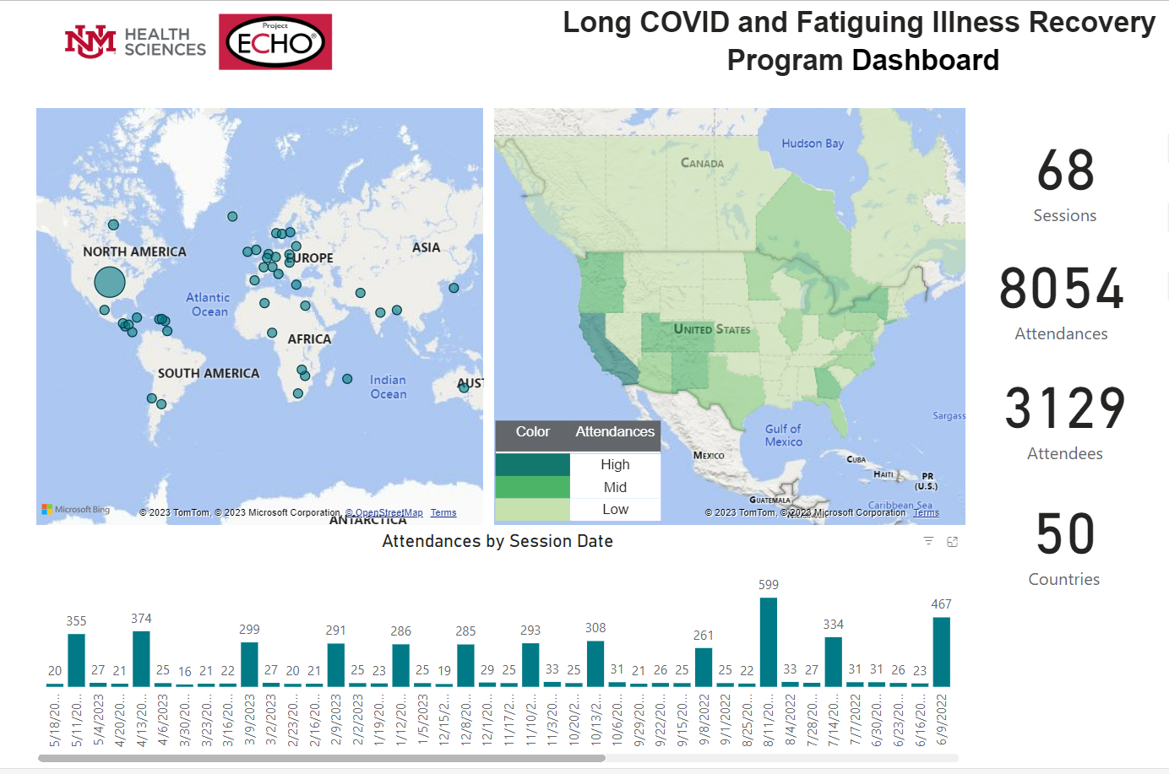

Long COVID and Fatiguing Illness Recovery Program (LC&FIRP)
Evaluate multi-disciplinary team approach delivered via telemedicine to:
  Improve care for patients with Long COVID, ME/CFS, and post-infection fatiguing illnesses
  Empower primary care providers in safety-net clinics to diagnose and care for these patients
  Disseminate advances and promising management practices
Schmidt Initiative on Long COVID is modeled after LC&FIRP
https://iecho.org/echo-initiatives/silc
BMC Trials 24:524, 2023

Slide 24
ME/CFS clinical experience helped LC&FIRP
Lived experience experts in every session, many of whom had ME/CFS
  Shared clinical experiences faced by Long COVID patients
  Established patient-centered dialogue
Clinical consultants included ME/CFS physicians
  Emphasized importance of avoiding post-exertional malaise
  Noted that triggering pathogen is often not documented or known
  Shared information on diagnosis and symptom management
  U.S. ME/CFS Clinician Coalition
  Suggested NASA lean test to diagnose postural orthostatic hypotension (POTS)
  ECHO Session webinars for providers with CME
https://iecho.org/program/PRGM1699044218879IERCAXHJ8Y/details
https://sites.google.com/view/lcfirp/home

Slide 25
Conclusions and Resources

Slide 26
Conclusions
Long COVID is a real, serious and disabling infection-associated condition that has affected millions of people
Long COVID disproportionately impacts women, certain racial and ethnic minority groups, persons who had severe acute COVID, and persons who are not vaccinated
COVID-19 vaccination is the best public health intervention to prevent Long COVID
ME/CFS remains a poorly understood and complex biologic illness
Most post-COVID conditions can be diagnosed and managed by primary care
Clinical guidance and multi-disciplinary care is needed
Inability to find healthcare from providers with understanding of these illnesses remains the biggest problem faced by patients
People with lived experience provide invaluable insights

Slide 27
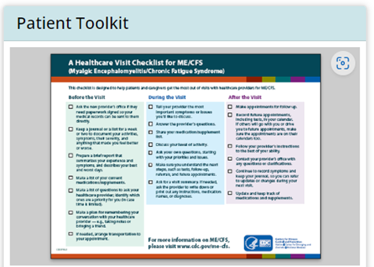
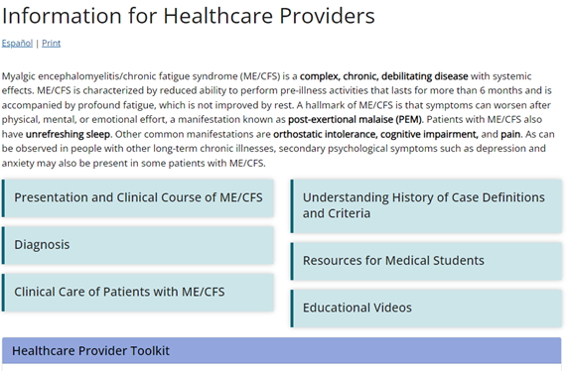
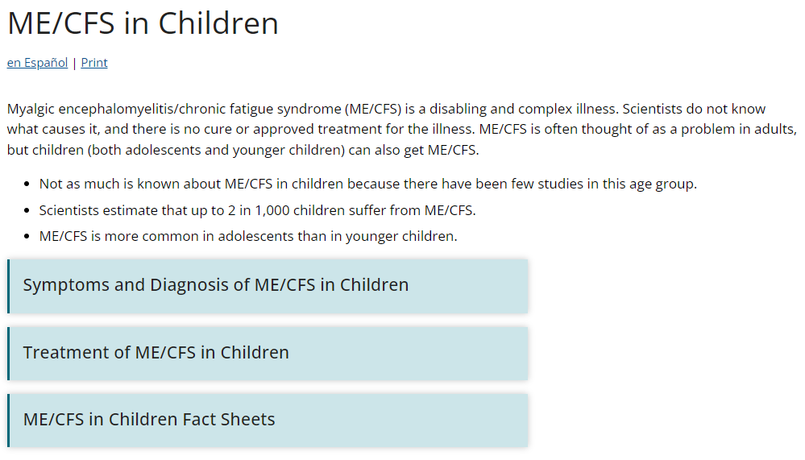
CDC’s website as educational resource – examples
https://www.cdc.gov/me-cfs/index.html
Calls/Webinars | Clinician Outreach and Communication Activity (COCA) (cdc.gov)

Slide 28


Medscape CME – Current course online
Roundtable Format
0.5 Credits – Medical and Nursing
https://www.medscape.org/viewarticle/995777

Slide 29
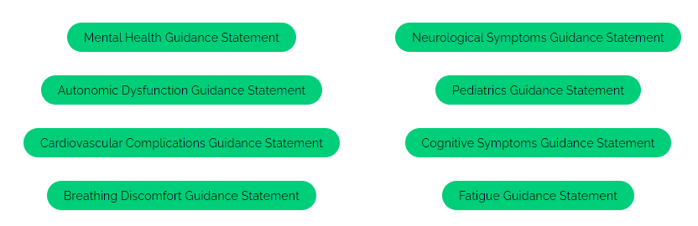
Multi-disciplinary Consensus Guidance – PASC Collaborative
Organized by American Academy of Physical Medicine and Rehabilitation (AAPM&R)
PASC Guidance (aapmr.org)

Slide 30
Acknowledgements
The patients that have contributed their perspectives
CDC ME/CFS program
CDC Long COVID program

Slide 31
Discussion Questions
What has been your experience with rehabilitative services to treat Long COVID?
What are the current gaps in the continuum of care for Long COVID?

