Slide 1
APTA National Advocacy Dinner
Notes:
Thank you for joining YOUR SCHOOL’S National Advocacy Dinner! This annual event is meant to inform students of the importance of advocacy and why getting involved throughout your career is vital in protecting the future of the PT profession. Your participation in physical therapy advocacy is crucial in advancing policies that will positively impact the profession. In this presentation, you will learn about some of the issues APTA advocates for and how you can get involved not only now, but throughout your career. As the saying goes, if you aren’t at the table, you’re on the menu.

Slide 2
The Importance of Advocacy
Notes:
Participating in advocacy is essential to the future and advancement of the physical therapy profession. Laws are made at all levels of government that impact the profession, including how you can practice, how you are paid, how patients are treated, among many other outcomes. If the physical therapy profession doesn’t have a seat at the table where these decisions are being made, laws and regulations may be passed that would harm the profession. We have to both speak up on the issues we work on and educate lawmakers about what physical therapy is and how it impacts people‘s lives.
TRANSITION: So why do we need YOU to get involved?

Slide 3
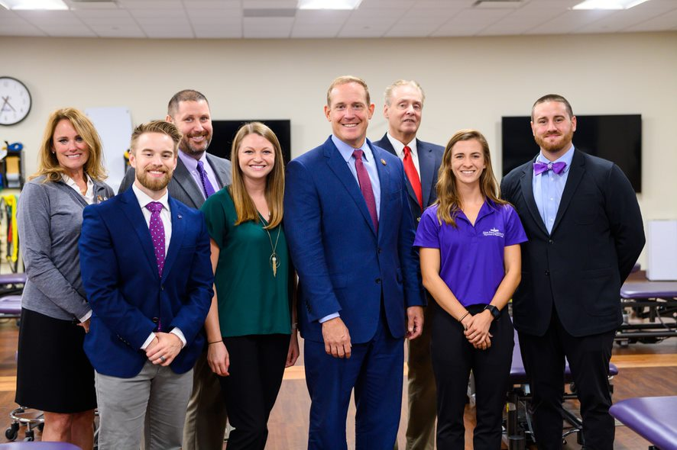
Why Get Involved?
Advocacy directly impacts the physical therapy profession
Legislators want to hear from you
If we don’t raise our voices, who will?
If you’re not at the table, you’re on the menu
Notes:
We have to work on all levels, with all political parties, all across the country, to accomplish our advocacy goals. We do this by meeting with legislators on Capitol Hill, sending letters from APTA members to members of Congress, going to fundraisers through PTPAC, APTA’s political action committee, working with government officials at places like the Centers for Medicare and Medicaid Services (CMS) and the National Institutes of Health (NIH), submitting comment letters on regulations, meeting with the administration, and working with coalitions of other health associations. Our strong grassroots network, bolstered by your involvement and active participation, is essential to our success. Your voice, as the constituent, is powerful. Legislators want to hear from you and they have an interest in hearing what you, the person who votes for them, has to say. We need PTs and PTAs to consistently educate and communicate with legislators to achieve our goals.
You are the expert on physical therapy. Whether advocating in the halls of Congress, in your district, or at the regulatory level, your stories are important and bring the physical therapy profession to the attention of our government officials is essential.
TRANSITION: What are some of the issues we work on and how do we work with Congress?

Slide 4
APTA Public Policy Priorities, 2023-2024
Notes:
To help guide our advocacy work, APTA establishes public policy priorities every two years in conjunction with the start of a new session of Congress. This document is created by several APTA committees with the input of APTA members.
The 2023-2024 Public Policy Priorities provides a “big picture” of the role and value of physical therapy in the health care system and how PT can improve outcomes, reduce costs, and transform society. It is an external document with the primary audience being members of Congress, their staff, and federal agencies. Highlighted are policy objectives and issues important to the profession that Congress and the Administration needs to address. It is not an exhaustive list of all the policies and specific bills that APTA is advocating for but meant to emphasize major policy areas and educate about PT.
This document was sent to every member of Congress in February 2023 so they know what we stand for and are aware of our priorities.
TRANSITION: You may remember hearing about how a bill becomes a law during your high school government class or the famous School House Rock “I’m Just a Bill”. How exactly does APTA engage with the federal government and how do you fit into this?

Slide 5



Three Branches of Government
Legislative
Executive
Judicial
Notes:
The ‘federal government’ may seem abstract, but APTA has a team in Washington that works daily on policy issues that impact the profession and relies on APTA members like you to reach out to your lawmakers and give your constituent perspective. The APTA Government Affairs team monitors issues that may impact the profession so we are informed and can be prepared to act. But how does it all work?
First, APTA works frequently with the legislative side, meaning the House and Senate. There are 435 members in the House of Representatives, and the number of representatives varies by the population of the state. The Senate has 100 members and there are two Senators per state. Laws are introduced in each chamber and are sent to a committee. Committees take a deeper dive into legislation, work out drafts of the bill, debate the bill, and hear from stakeholders in hearings and briefings. Certain committees take on certain topics, and physical therapy issues are most likely to go through the House Energy and Commerce and Ways and Means Committees or the Senate Finance and Health, Education, Labor and Pensions Committees. Building relationships with members of Congress who sit on those committees are crucial in advancing our legislation.
APTA engages on the executive/regulatory side by meeting and engaging with the Department of Health and Human Services, or HHS, the Centers for Medicare and Medicaid Services, or CMS, Dept. of Veterans Affairs, and many other agencies. These regulatory bodies are enormously influential in practice, payment and other issues that can impact the day-to-day work of PTs and PTAs. We have to engage with these government officials to ensure they are approving regulations that help the profession. As an advocate, an important and easy way to engage is by sending a comment to an agency when a rule is proposed.
To implement or change laws, federal agencies undergo a process called notice and comment rulemaking. Federal agencies publish thousands of proposed rules each year through this notice and comment rulemaking process and solicit public comment to hear from stakeholders and others about the impact of these proposed regulations. Submitting comments on these proposed rules is one of the primary ways to influence changes to regulation.
APTA has a regulatory action center where comment opportunities are highlighted and a template comment letter is often provided for your use, and you can add your personal story if you wish.
TRANSITION: What does Congress have to do with the future of the physical therapy profession?

Slide 6
What Congress Does Affects Your Future
Physical therapy issues are addressed in Congress and by federal agencies
  Payment
  Scope of practice
Raising your voice is important so they can know how policies will impact the profession
Building relationships with legislators
  APTA members
  APTA lobbying support
Notes:
Congress has immense influence over the future of the physical therapy profession. Congress and federal agencies work on issues that address payment and scope of practice. Without PTs and PTAs raising their voices with their lawmakers about these issues and how legislation will impact them, their patients, and practice, laws could be passed that negatively impact the profession.
By raising your voice, educating members of Congress about physical therapy, and being continually engaged in advocacy, you can impact the future of the profession.

Slide 7
Congressional Advocacy
It’s all about relationships
  Connecting and building relationships with your legislators is important so they can know how policies will impact the profession
  Members who are on committees of jurisdiction are important
    House Energy & Commerce, Ways & Means
    Senate HELP, Finance
  Your voice is bolstered by APTA lobbying support
Notes:
Building relationships with legislators and their staff is essential. These relationships are essential so they know how policies will impact the physical therapy profession.
Members of Congress who are on particular committees of jurisdiction are important to know. These committees are typically in charge of legislation that impacts the profession and has the ability to decide which bills make it through the committee or not. On the House side, the Energy & Commerce and Ways & Means committees usually deal with health care/physical therapy issues. On the Senate side, the Health, Education, Labor and Pensions, or HELP Committee and Finance Committee, take up physical therapy bills.
With APTA lobbying support on Capitol Hill, your voice is amplified to help pass bills favorable to the profession.
TRANSITION: If we’re building relationships with members of Congress and their staff, how is a congressional office set up?

Slide 8
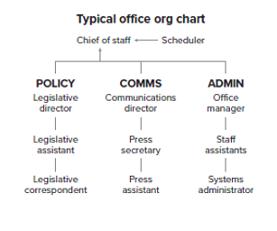
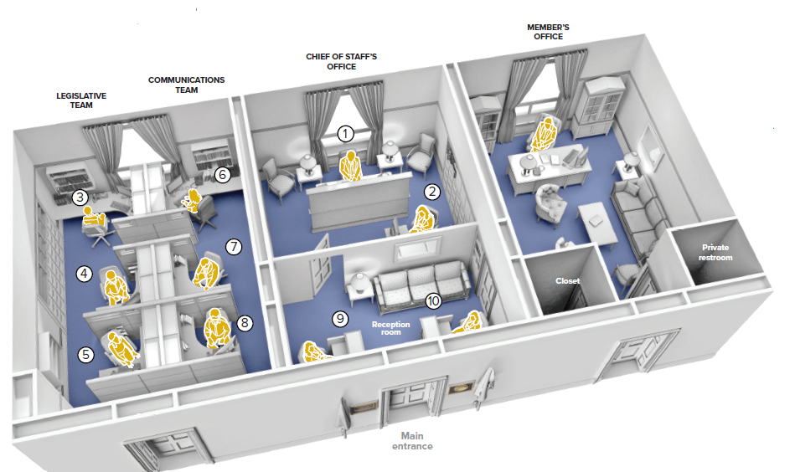
Congressional Offices
Notes:
Most Congressional offices, in both chambers, have similar office setups. The chief of staff works directly under the member of Congress and is in charge of overall office operations, communications, and policy staff.
Policy staff are in charge of various issues, ranging from defense to veterans’ affairs, to the environment. There are policy staff, called legislative assistants, that work on health issues. These staffers have the ear of the member of Congress on health issues, so this is an essential person to get to know in in the office. Legislative correspondents receive and answer email and monitor the social media accounts of the legislator.
Communications staff put out press releases, monitor news, and engage on social media on behalf of the legislator.
Administrative staff are in charge of the operations side of the office and are usually who you speak to when you call a member of Congress.
TRANSITION: When you meet with a member of Congress and their staff, what is the most important thing you can say?

Slide 9
Telling Your Story
We all have a story
Legislators want to hear from you and know how you impact your community
Telling your story also shows the impact legislation will have on:
  Your patients
  Your community
  Your clinic/business
Notes:
Everyone has a story. No matter who we are or what we do, we all have a story to share that can make a big impact.
Many members of Congress aren’t aware of what physical therapy is and how it helps people. It is up to us to educate legislators about PT and the impact it has on your community. Members of Congress were elected to serve the community and they want to hear from you.
Telling your story, tied to a legislative issue, can make the issue come alive and show in real ways how it will impact your patients, community, school, clinic or business. Remember, you are the expert!
TRANSITION: What opportunities do APTA members have to connect with legislators?

Slide 10
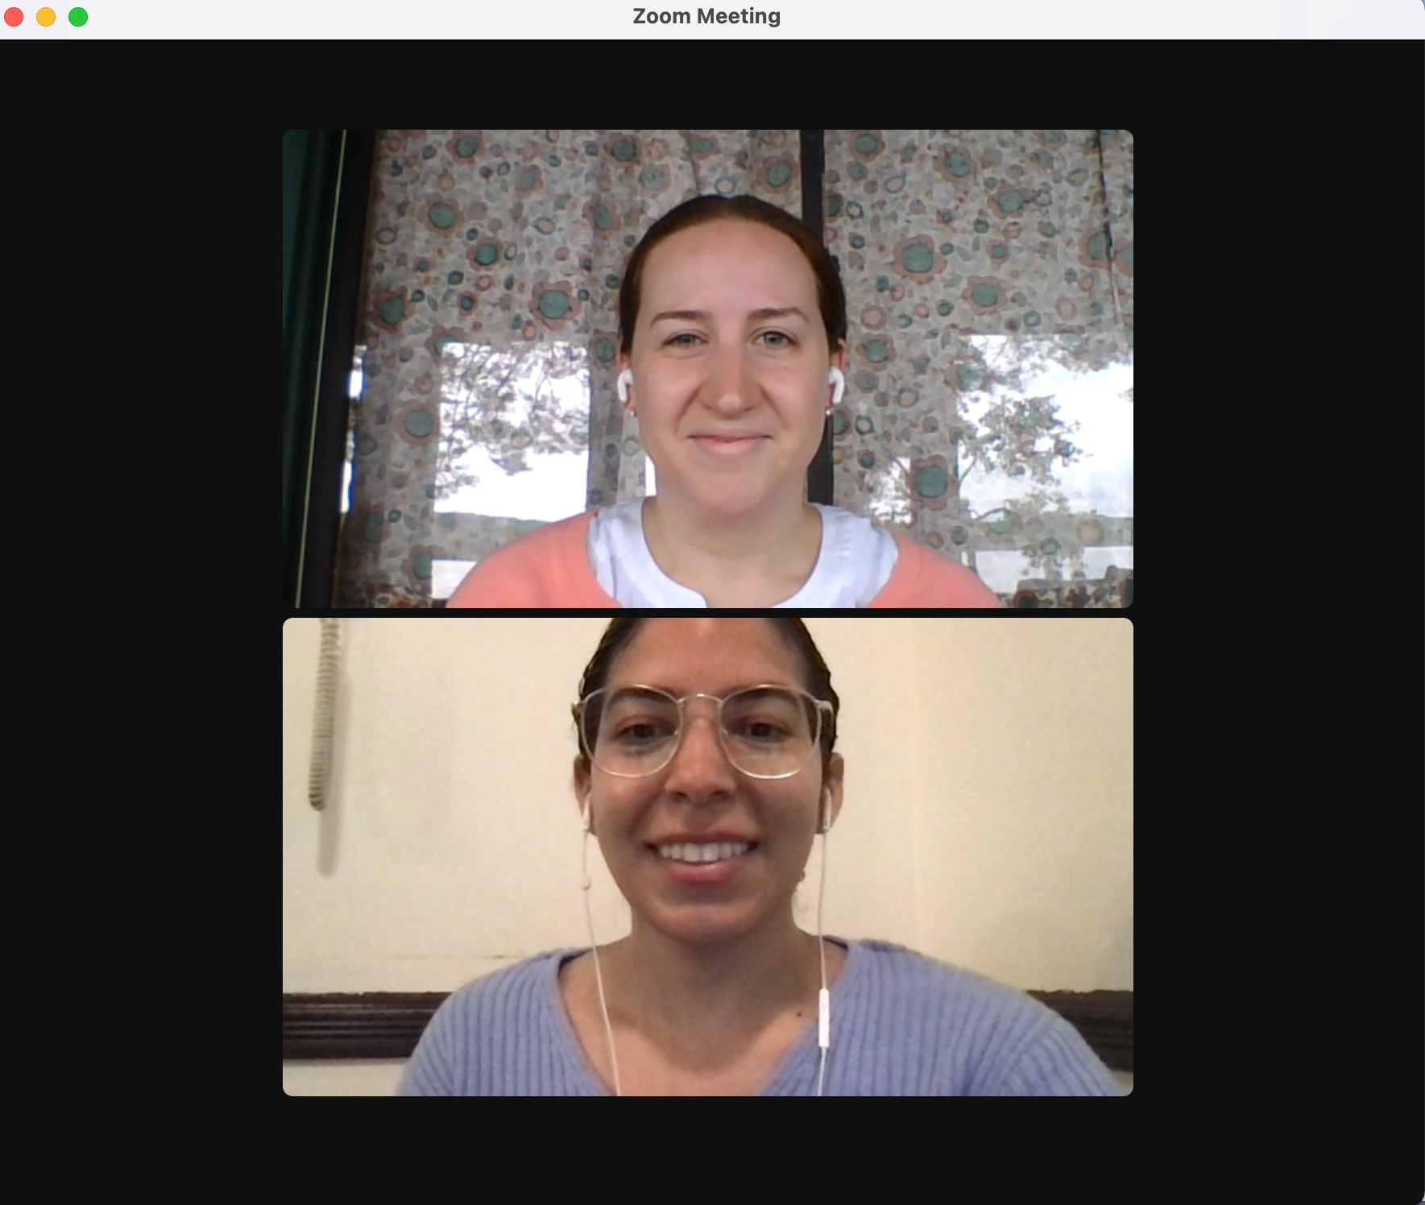
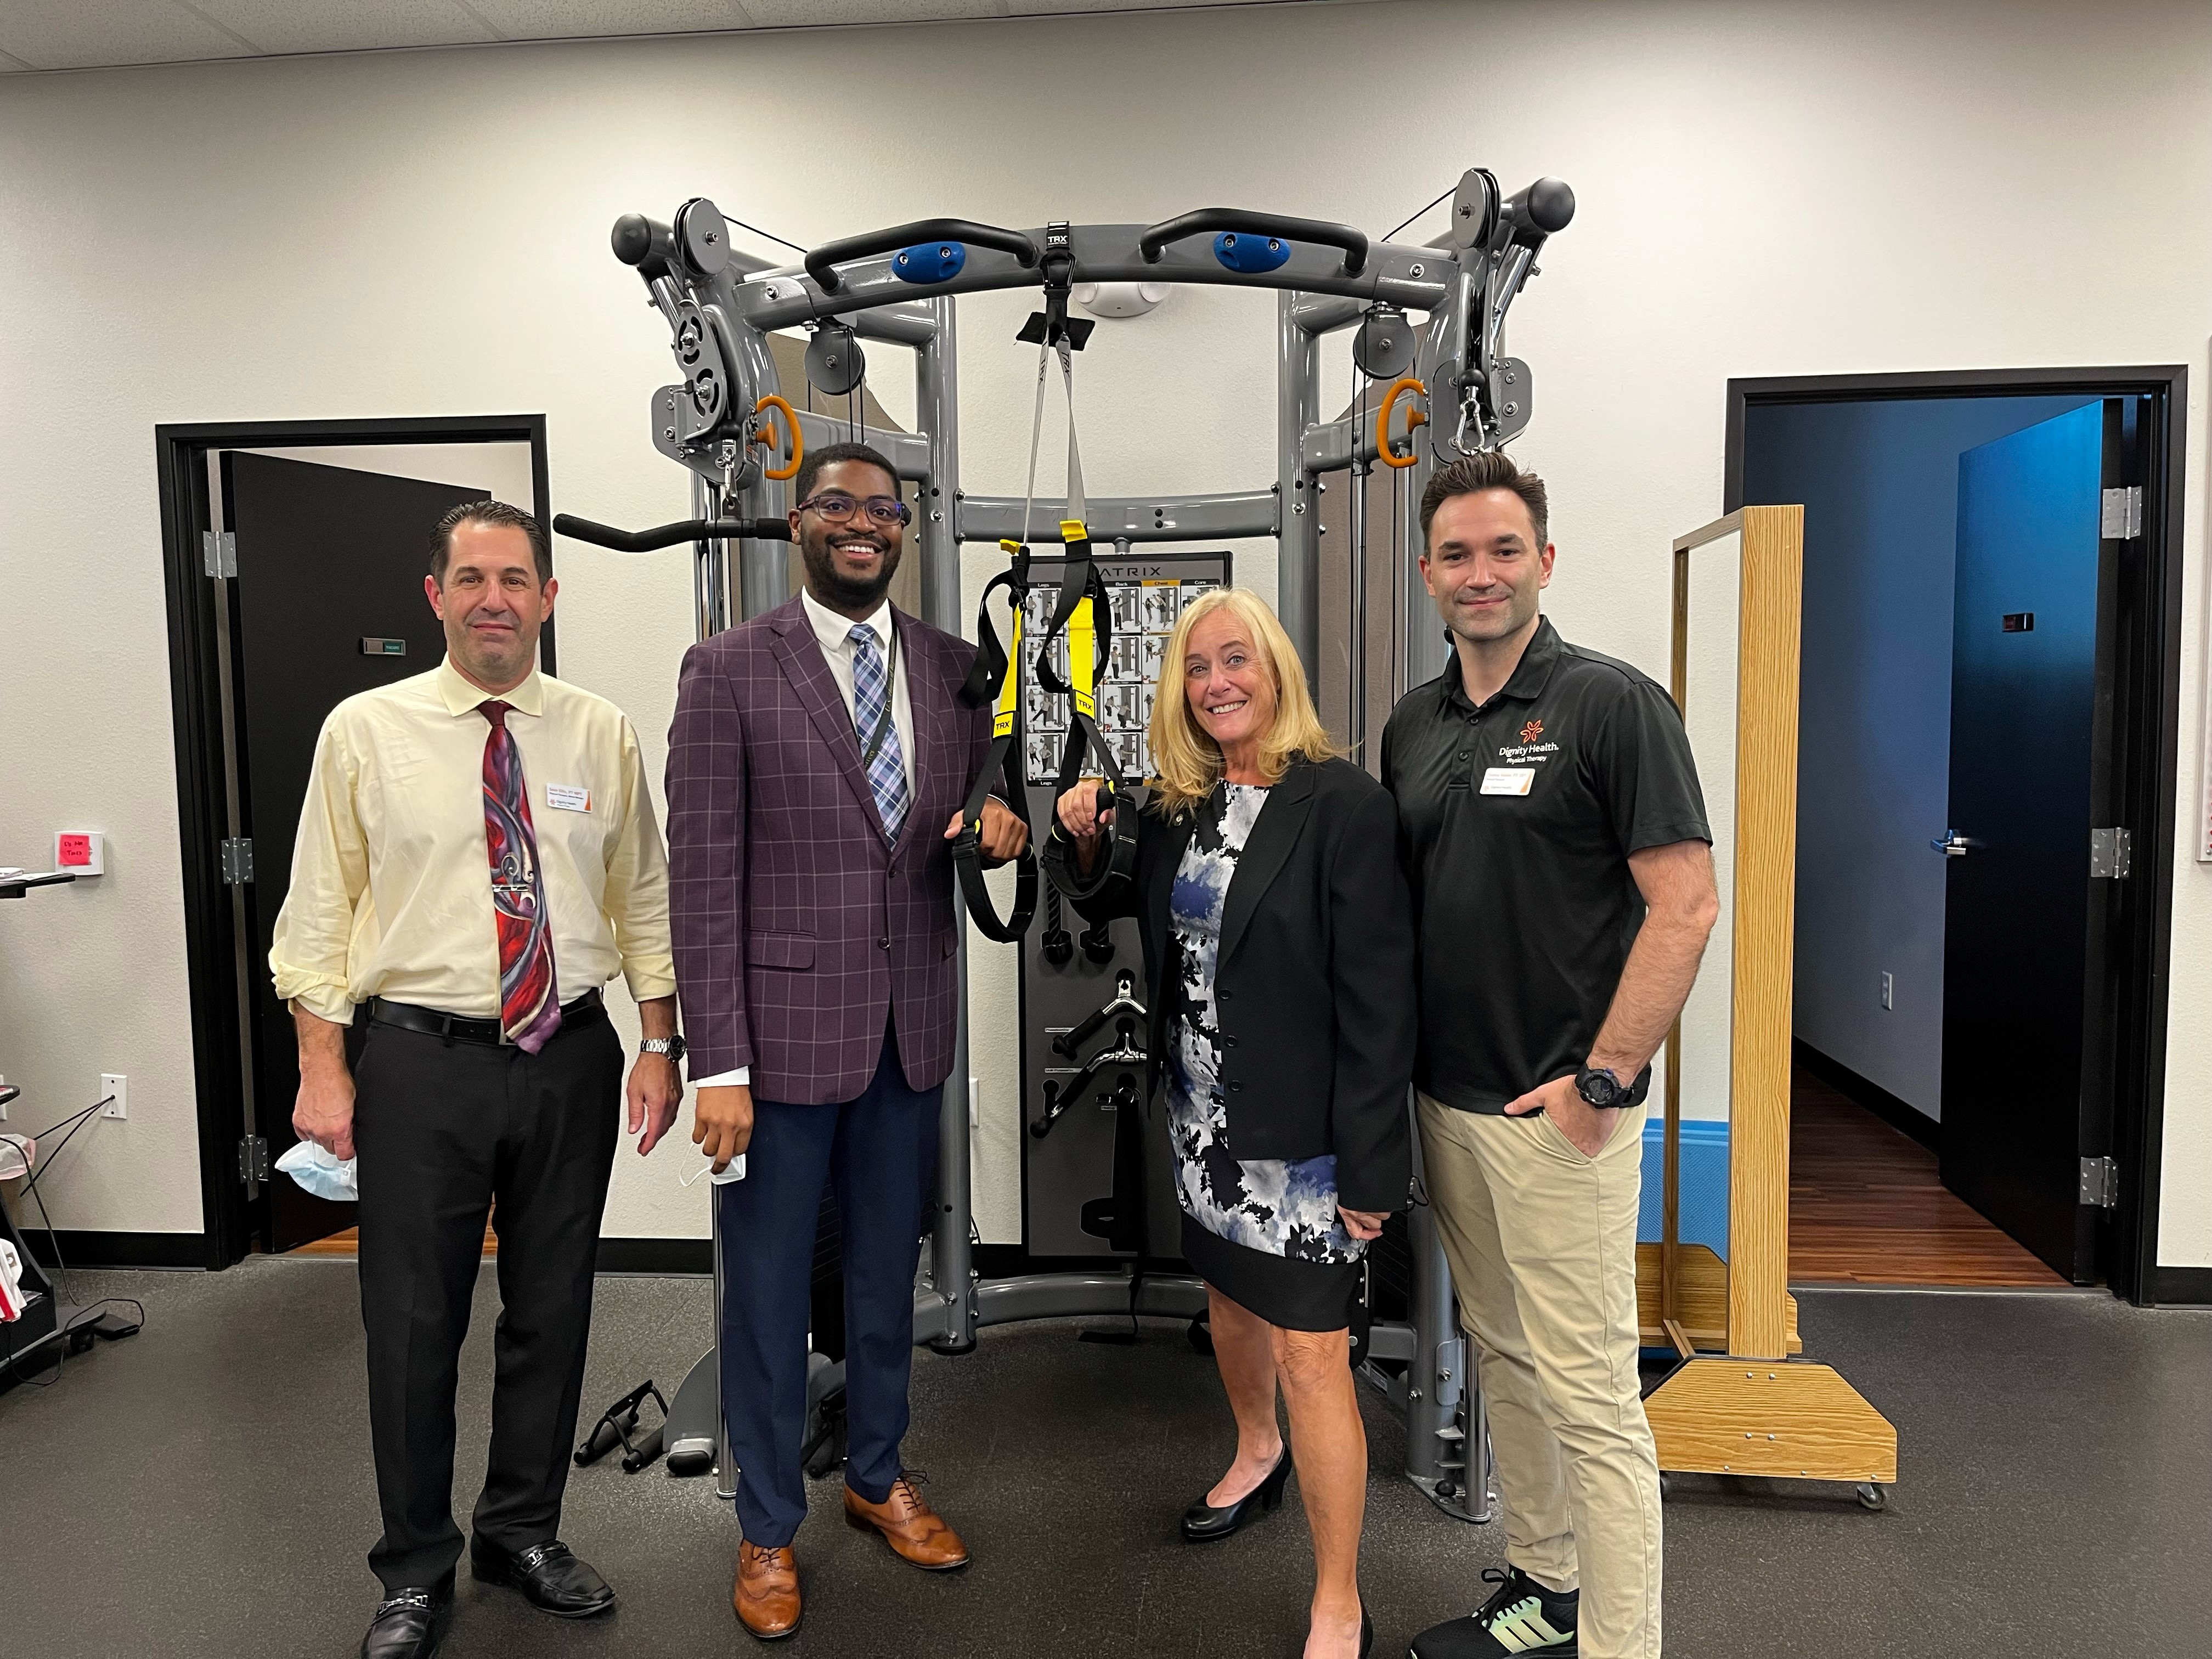
APTA Opportunities to Meet with Legislators
PT Day on Capitol Hill
  July 24-25, 2023
Practice/clinic/school visits
Virtual meetings
Local events
Town halls
Fundraisers
August Recess
Notes:
There are many ways to connect with members of Congress both at home and in Washington, DC.
In 2023, APTA is hosting PT Day on Capitol Hill July 24-25 in Washington, DC in conjunction with the APTA Leadership Congress. Attendees will receive advocacy training the evening of July 24 and will be meeting with their members of Congress and staff on Capitol Hill all day on July 25. We hope to see you there!
APTA members can ask to host a member of Congress at their practice, clinic, or school, to give them a hands-on and memorable learning experience. You can also visit the legislator’s district office and meet there. Virtual meetings are and option and an easy and convenient way to connect with legislators and staff.
You’re encouraged to sign up for your legislator’s newsletters and follow them on social media to find out when they are hosting local events or town hall meetings. PTPAC can provide opportunities to attend a local fundraiser.
August Recess is a great time to meet with a legislator since Congress adjourns for the month and goes back to work in their districts. Legislators expect to meet with their constituents during congressional recesses. Getting a physical therapy experience on their schedule is important.
TRANSITION: Now that we know how we can connect with legislators, what issues do we work on?

Slide 11
APTA Policy Work
Notes:
APTA has numerous issues we work on and monitor. This section will give you a brief overview of some issues that we advocate on behalf of the profession at the federal level.

Slide 12
118th Congress Bill Introduction
Payment reform
  PTA supervision
Medicare Opt Out
Locum tenens
Pelvic health
National Health Service Corps
Community health centers
Telehealth
SHARE act
Notes:
At the start of each new Congress, all bills that were not passed in a previous Congress must be reintroduced.
APTA is working to have all of its priority bills reintroduced in the new 118th Congress, including legislation that would address a long-term solution to the Medicare Physician Fee Schedule. Congress must take action to ensure the financial stability and predictability of Medicare payment, reward value-based care, safeguard timely access to high-quality care, and reduce disparities. Long-term reforms are needed to the Medicare Physician Fee Schedule to break the year-over-year cycle of cuts to providers and provide stability to both patients and providers.
Since the fee schedule is the only payment system within Medicare lacking an annual inflationary update, clinicians, many of whom are small business owners, contend with a wide range of shifting economic factors when determining their ability to provide care to Medicare beneficiaries.
APTA is also working on legislation that would change the current outdated "direct supervision" requirement of PTAs in private practice to general supervision.
The Medicare opt out bill would allow a Medicare beneficiary to enter into a direct contract with an eligible provider, including physical therapists, for any item or service covered by Medicare, otherwise known as "opting out" of Medicare.
Locum tenens is where a qualified PT can arrange for another qualified PT to treat their patients during a temporary absence due to illness, vacation, continuing education, pregnancy, and other events. Currently, only PTs in rural and underserved areas are allowed to participate in locum tenens and still receive payment from Medicare. The locum tenens bill would expand the ability of all PTs to engage in this program.
The pelvic health bill would direct the HHS Secretary to develop provisions that would significantly strengthen Medicaid's emphasis on pelvic care for individuals in the postpartum period. The legislation includes pelvic floor physical therapy among the pelvic floor services that would be covered under Medicaid and the Children's Health Insurance Program.
The National Health Service Corps bill would allow PTs to participate in the NHSC loan repayment program, an initiative that repays up to $50,000 in outstanding student loans to certain health care professionals who agree to work for at least two years in a designated Health Professional Shortage Area.
The community health centers bill would expand patient access to essential physical therapist services to children and adults who receive care at rural health clinics and federally qualified health centers, also known as community health centers.
The bill on telehealth instructs CMS to permanently adopt what is currently a temporary waiver of restrictions on Medicare payment for telehealth delivered by PTs and PTAs and other therapy providers.
The SHARE Act addresses the use and sharing of information related to FBI background checks with state licensure boards and interstate compact commissions.
TRANSITION: These bills are just a handful of the issues APTA works on behalf of the profession. How can APTA members take action on this legislation?

Slide 13
Getting Involved
Notes:
APTA members have many opportunities for students to get involved, learn more about advocacy, and raise their voices with lawmakers. Students are encouraged to be lifelong advocates, and however you advocate, you don’t need a lot of time to participate.

Slide 14
Student Advocacy Programs – Student Advocacy Challenge
Simple ways to get started in advocacy
Programs compete against each other by participating in advocacy activities
Submit activities for credit through APTA website or APTA Advocacy App
January 2023-December 2023
Notes:
The Student Advocacy Challenge is a competition among PT and PTA programs to participate in advocacy activities for points. On the Student Advocacy Challenge website, there is a menu of activities that you can complete for points. In fact, participating in this National Advocacy Dinner counts for points toward the Challenge!
You can submit your activities for credit through the APTA website or APTA Advocacy App. The Challenge runs from January 2023-end of December 2023. The winning program will not only get bragging rights, but featured on APTA’s website and will receive a virtual or in-person presentation by an APTA staff or Board member of the program’s choice.
TRANSITION: How else can students get involved in advocacy?

Slide 15
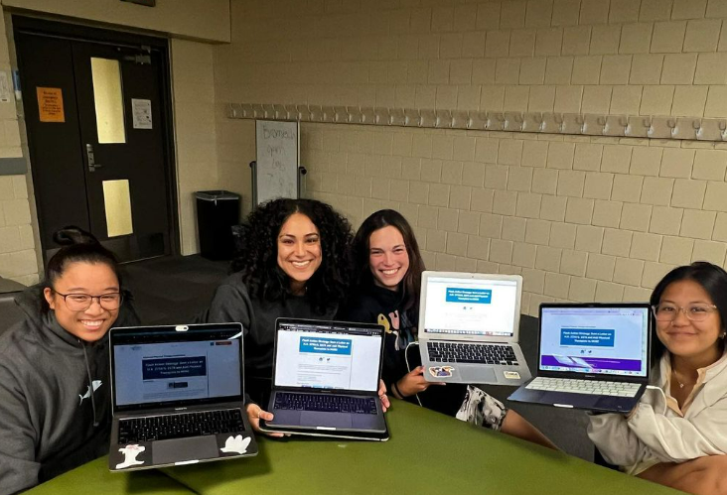
Student Advocacy Programs – Flash Action Strategy
Two-day, student-led social media blitz
Focused around an issue impactful to students
Raise awareness with legislators
Notes:
You’re already taking a first step by participating in this dinner. In the fall, students can participate in Flash Action Strategy. Flash Action Strategy is a two-day, student-led social media blitz focused around an issue impactful to students. This two-day push includes connecting with your legislators on social media and sending letters to your members of Congress. In the past few years, students participating in FAS have been responsible for over 80,000 letters going to Congress. Be on the lookout for more information over the summer and the 2023 Flash Action Strategy will be sometime in September.
TRANSITION: How can you participate throughout your career?

Slide 16
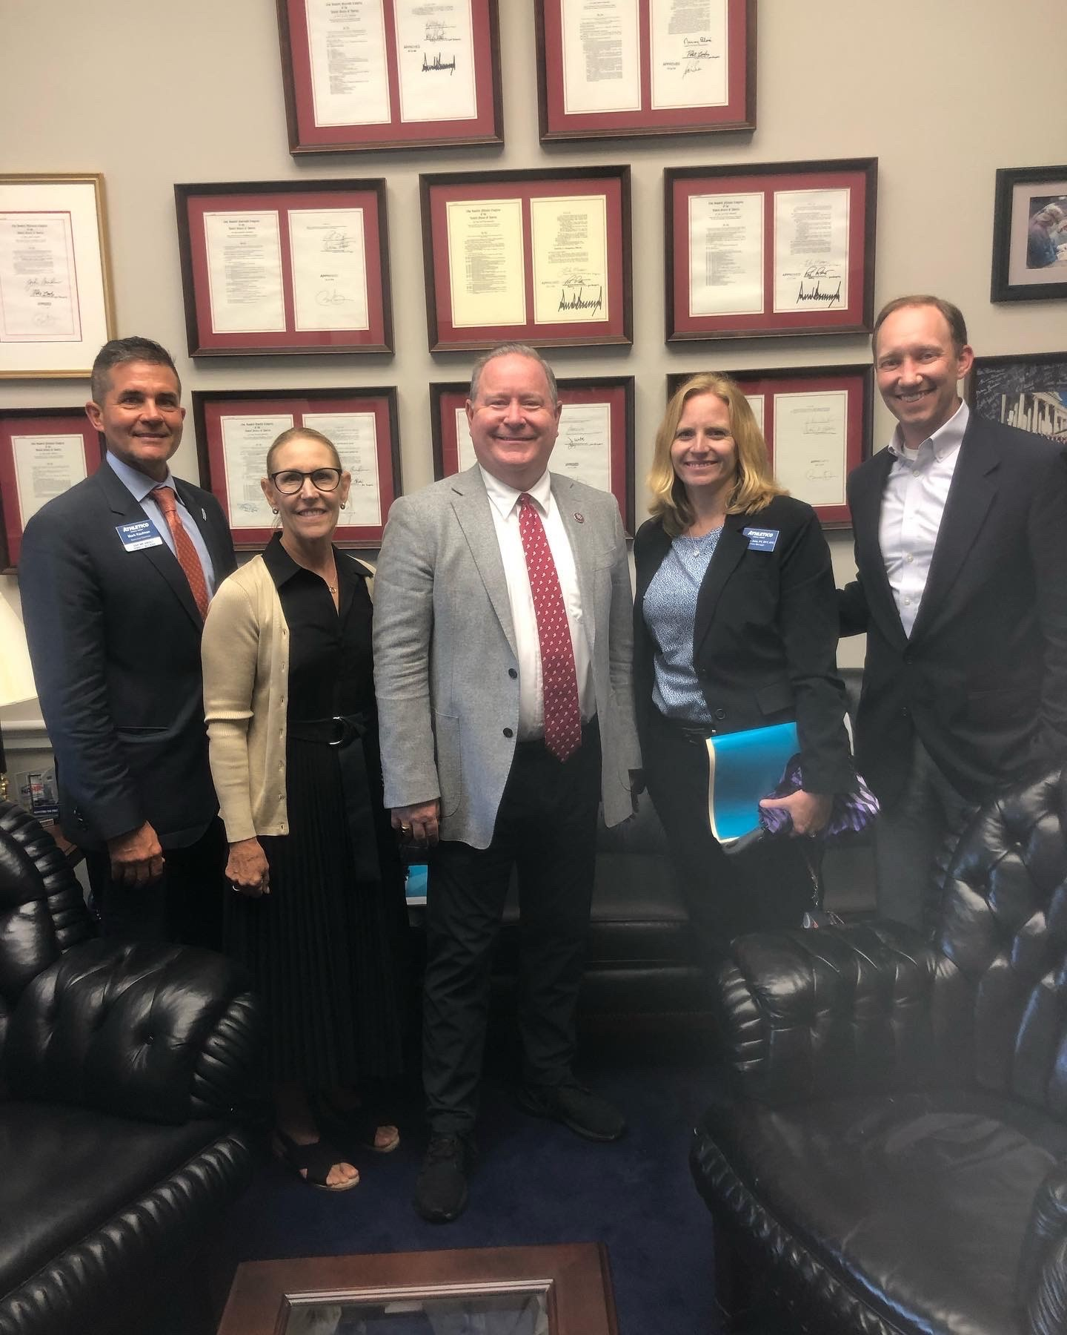
Advocacy Throughout Your Career
APTA Advocacy Network
Key Contact Program
  Form and build relationships with members of Congress
  Educate about physical therapy
  Provided with training information to help you
Notes:
No matter how much time or how you are able to participate, your voice matters and is critical to our success.
The easiest way to participate in advocacy is to become a member of the APTA Advocacy Network. Exclusive to APTA members, the APTA Advocacy Network is our strength in numbers. Members of the APTA Advocacy Network receive action alerts to send an email to their members of Congress when we need to garner support on an issue. They also receive information bulletins on breaking news, and a newsletter every other month.
The Key Contact program helps APTA members form and build relationships with their legislators to help advance priority legislation. We provide training and guides to help Key Contacts build and foster these relationships. The time commitment is what you’re able to give and the only prerequisite or requirement is to be an APTA member. Key Contacts are encouraged to participate in August Recess, where they meet (either in-person or virtually) with the member of Congress. There are also various outreach activities throughout the year, depending on the needs of our legislative campaigns.
TRANSITION: What tools are available to help advocates in their work?

Slide 17


Advocacy Tools for You
Legislative Action Center
  APTA members only
Patient Action Center
  Public and shareable
APTA Advocacy App
  Advocate in minutes from your phone
Notes:
There are many tools for APTA members to engage with Congress. The Legislative Action Center, for APTA members only, has pre-written emails and social media posts you can send to your members of Congress. The Patient Action Center also has pre-written emails and is available to non-members, patients, friends, family, and others.
APTA members can take the following steps to raise your voice, be informed of our work, and participate:
Visit the App Store or Google Play and download the APTA Advocacy App. You can sign up for the Network there, send letters to your members of Congress, view advocacy training videos, and learn about our policy issues. The app makes it easy to advocate from anywhere.
Sign up to the APTA Advocacy Network, if you haven’t already.
Become a Key Contact. Reach out at advocacy@apta.org or find the opportunity through APTA Engage.
Support PTPAC
Remember, you are a vital part of APTA’s advocacy program because you’re the constituent. Members of Congress work for you. Plus, you’re the expert! Your unique experience in the physical therapy profession is important and members of Congress need to hear from you.
TRANSITION: How does PTPAC advocate for the profession?

Slide 18
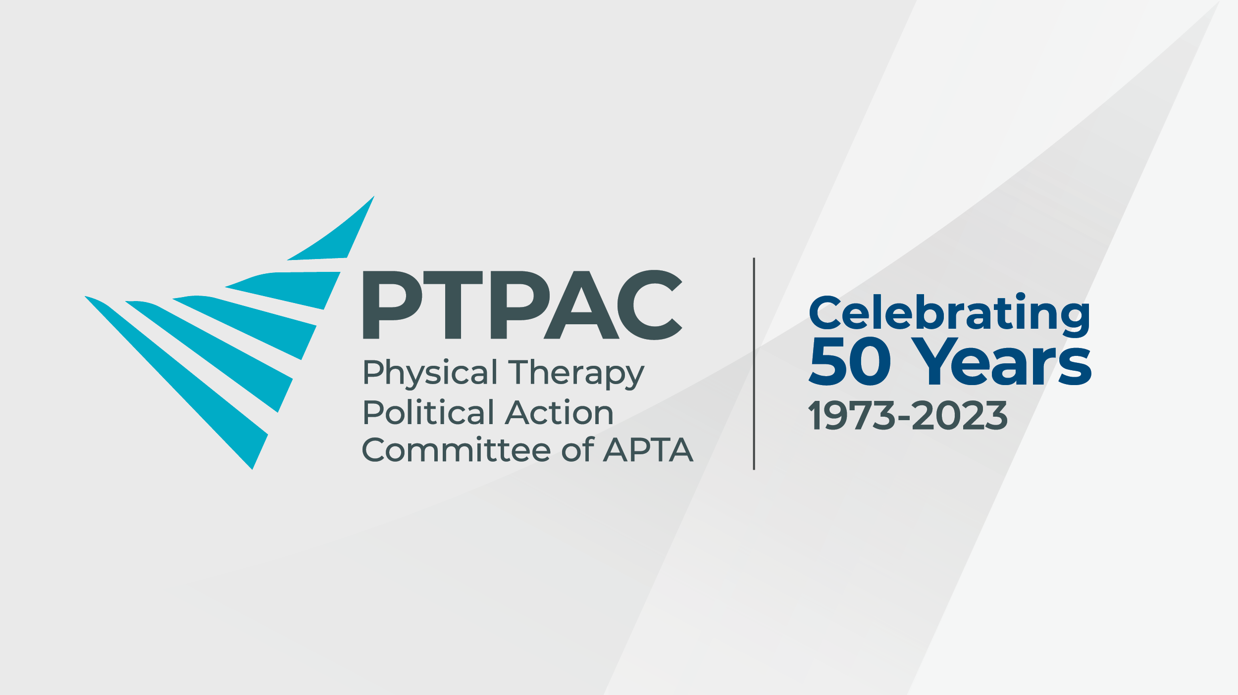
PTPAC
APTA dues do not go to PTPAC
Allows APTA members and staff to attend fundraisers
Important facetime with legislators
Student Star - $20
Coffee Club for early professionals
  - $60 per year
Notes:
PTPAC is the political action committee of APTA and relies on voluntary donations from APTA members, not member dues, to have our voice heard in Congress. For 50 years, PTPAC has made a difference by connecting directly with legislators and supporting those who champion physical therapy. Many organizations have a political action committee. We need a strong PAC to have a seat at the table. How does PTPAC help the profession?
Supports PT-friendly members of Congress in their election campaigns.
Provides opportunities for APTA members and staff to directly talk to members of Congress at fundraisers about the issues of concern to the profession.
Builds relationships with members of Congress and staff through fundraisers that APTA staff and members can attend.
Support PTPAC by donating $20 and becoming a Student Star.
For APTA members 5 years and under out of PT school, they can join the Coffee Club. For $60 per year, members connect with each other, hear from special guest speakers about advocacy, and network.
TRANSITION: Are you ready to begin your advocacy journey? Are you ready to make an impact for the physical therapy profession?

Slide 19
Questions?
advocacy@apta.org
Notes:
Now, we can pause for questions. If you have any additional questions, please reach out to the APTA Government Affairs team at advocacy@apta.org
Thank you for attending the 2023 National Advocacy Dinner! Remember, if we’re not at the table, we’re on the menu. Our collective and persistent efforts will pay off for the future of the physical therapy profession. Always remember that your voice matters and makes a difference. We look forward to your participation in APTA advocacy programs.

