Slide 1
National Advocacy Dinner 2022
YOUR SCHOOL HERE
Notes:
Thank you for joining YOUR SCHOOL’S National Advocacy Dinner! This annual event is meant to inform students of the importance of advocacy and why getting involved throughout your career is important. Your participation in physical therapy advocacy is crucial in advancing policies that will positively impact the profession. In this presentation, you will learn about some of the issues APTA advocates for and how you can get involved not only now, but throughout your career. As the saying goes, if you aren’t at the table, you’re on the menu.

Slide 2
The Importance of Advocacy
Notes:
Participating in advocacy is essential to the future and advancement of the physical therapy profession. Laws are made at all levels of government that impact the profession, including how you can practice, how you are paid, how patients are treated, among many other outcomes. If the physical therapy profession doesn’t have a seat at the table where these decisions are being made, laws and regulations may be passed that would harm the profession. We have to both speak up on the issues we work on and educate lawmakers about what physical therapy is and how it impacts people‘s lives.
TRANSITION: So why do we need YOU to get involved?

Slide 3
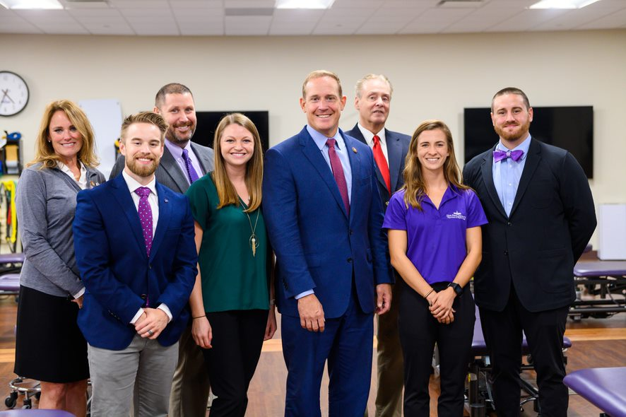
Why Get Involved?
Advocacy directly impacts the physical therapy profession
If we don’t raise our voices, who will?
If you’re not at the table, you’re on the menu
Notes:
We have to work on all levels, with all political parties, all across the country, to accomplish our advocacy goals. We do this by meeting with legislators on Capitol Hill, sending letters from APTA members to members of Congress, going to fundraisers through PTPAC, APTA’s political action committee, working with government officials at places like the Centers for Medicare and Medicaid Services (CMS) and the National Institutes of Health (NIH), submitting comment letters on regulations, meeting with the administration, and working with coalitions of other health associations. Our strong grassroots network, bolstered by your involvement and active participation, is essential to our success. Your voice, as the constituent, is powerful. Legislators want to hear from you and they have an interest in hearing what you, the person who votes for them, has to say. We need PTs and PTAs to educate and work with legislators to achieve our goals.
There are many ways that APTA advocates. Whether advocating in the halls of Congress, in your district, or at the regulatory level, your stories are important and bring the physical therapy profession to the attention of our government officials is essential.
TRANSITION: What are some of the issues we work on and how do we work with Congress?

Slide 4
Our Work
Notes:
APTA has numerous issues we work on and monitor. This section will give you a brief overview of how Congress works and some of the issues that we are advocate on behalf of the profession at the federal level.
TRANSITION: How does APTA decide what issues to advocate for?

Slide 5
APTA Advocacy Work
APTA works on many issues at the federal level
Lobbying staff in Washington, DC that works with Capitol Hill daily on behalf of the profession
Notes:
To help guide our advocacy work, APTA establishes public policy priorities every two years in conjunction with the start of a new session of Congress. APTA publishes a document outlining the policy priorities that Congress and regulators should address. It is created by several APTA committees with the input of APTA members.
This document, the 2021-2022 Public Policy Priorities, provides a “big picture” of the role and value of physical therapy in the health care system and how PT can improve outcomes, reduce costs, and transform society. It also highlights policy objectives and issues important to the profession that Congress and the Administration need to address. It is not an exhaustive list of all the policies and specific bills that APTA is advocating for – but meant to highlight major areas that encompass our legislative efforts.
It is an external document with the primary audience being members of the U.S. Congress, Hill staff, and federal agencies, meant to educate them about physical therapy. This document was sent to every member of Congress in February 2021 so they know what we stand for and are aware of our priorities.
TRANSITION: You may remember hearing about how a bill becomes a law during your high school government class or the famous School House Rock “I’m Just a Bill”. How exactly does APTA engage with the federal government and how do you fit into this?

Slide 6
How Does it Work?
Legislative
Congress (House and Senate)
Executive
President
Agencies (Centers for Medicare and Medicaid Services, Health and Human Services, etc.)
Judicial
Supreme Court
Federal Courts
Notes:
APTA has a team in Washington that works daily on policy issues that impact the profession and rely on APTA members like you to reach out to your lawmakers and give the constituent perspective. APTA Government Affairs monitors issues that may impact the profession so we are informed and can be prepared to act. But how does it all work?
First, APTA works frequently with the legislative side, meaning the House and Senate. There are 435 members in the House of Representatives, and the number of representatives varies by the population of the state and the Senate has 100 members with two Senators per state. Laws are introduced in each chamber and are sent to a committee. Committees take a deeper dive into legislation, work out drafts of the bill, debate the bill, and hear from stakeholders in hearings and briefings. Certain committees take on certain topics, and physical therapy issues are most likely to go through the House Energy and Commerce and Ways and Means Committees or the Senate Finance and Health, Education, Labor and Pensions Committees. Building relationships with members of Congress who sit on those committees are crucial in advancing our legislation.
APTA also engages on the executive/regulatory side by meeting and engaging with the Department of Health and Human Services, or HHS, the Centers for Medicare and Medicaid Services, or CMS, Dept. of Veterans Affairs, and many other agencies. These regulatory bodies are enormously influential in practice, payment and other issues that can impact the day-to-day work of PTs and PTAs. We have to engage with government officials to ensure they are approving regulations that help the profession. As an advocate, an important and easy way to engage is by sending a comment to an agency when a rule is proposed.
To implement or change laws, federal agencies undergo a process called notice and comment rulemaking. Federal agencies publish thousands of proposed rules each year through this process and solicit public comment to hear from stakeholders and others about the impact of these proposed regulations. Submitting comments on these proposed rules is one of the primary ways to influence changes to regulation.
APTA has a regulatory action center where comment opportunities are highlighted and a template comment letter is often provided for your use, and you can add your personal story if you wish.
Regulatory advocacy also involves APTA meeting with federal agencies and sending other written correspondence throughout the year. However, submitting comments during these public comment periods is the "formal" mechanism by which stakeholders can advocate for or against something (i.e., going on the record).
APTA monitors the judicial branch and issues guidance should a Supreme Court ruling impact the physical therapy profession.
TRANSITION: Since you may be new to this advocacy world, let’s go over a few terms you may encounter as an APTA advocate.

Slide 7
Important Government Terms
H.R. – House Resolution, or a bill in the House of Representatives
S. – A bill in the Senate
H.R./S. – a bill in both chambers
Committee of jurisdiction – group of legislators handles specific legislative topics
Cosponsor – showing support for a piece of legislation
HLA – Health Legislative Assistant
August Recess – annual district work period
Notes:
As you begin your advocacy journey, it’s important to know a few terms you will hear often.
First, when referring to legislation, you may see ‘H.R.’ or “S.” in front of bill numbers. ‘H.R.’ means House Resolution, or a bill in the House of Representatives and an ‘S.’ in front means it is a bill in the Senate. When you see both H.R. and S. with the respective bill numbers with regards to a similarly named piece of legislation, that means the bill is in both chambers.
A committee of jurisdiction is a legislative sub-organization in Congress that handles a specific duty or topic. Members of a committee develop specialized knowledge on the matters their committee handles. Committees study, review, and advance legislation.
Cosponsor means that a member of Congress adds their name to the list of supporters of a bill. The more cosponsors a bill receives, the more likely it will be taken up for consideration by chamber, pushing it further through the process to becoming law.
You’ll frequently hear the acronym HLA, or health legislative assistant. This is the staff member in the legislator’s office who is in charge of health care issues and advises the member of Congress on this topic. You want to get to know this person because they have the ear of the member of Congress on health issues and can be a great ally in support of APTA legislation.
And finally, August Recess. August Recess is the traditional district work period when members of Congress go back to their districts from late July to early September. This is an excellent opportunity to meet with members of Congress in your area, invite them to tour your school or in the future, your practice, attend a town hall, or meet face to face in their district office or elsewhere. Usually APTA has around 100 meetings that occur in August during the district work period and those meetings are important in advancing our legislation.
TRANSITION: What are some of the current issues APTA is advocating for?

Slide 8
Telehealth
Expanded Telehealth Access Act of 2021 (H.R. 2168)
PTs and PTAs can treat Medicare patients via telehealth under the current public health emergency (PHE).
Once the PHE ends, this goes away.
H.R. 2168 will make this practice permanent
What can you do? Send a letter from the Legislative Action Center to your representative.
Notes:
A current issue APTA is working on is to make telehealth permanent under Medicare. The ongoing coronavirus pandemic has highlighted the need for health systems and providers to rapidly modify the way care is delivered to patients. The list of approved telehealth providers was waived during the public health emergency, now permitting PTs and PTAs to treat patients via telehealth. Many patients, especially in rural and underserved areas, were able to receive effective physical therapy treatment through telehealth. This expansion has demonstrated that many needs can be safely and effectively met via telehealth and that patients can have improved access to rehabilitation services. However, when the public health emergency is declared over, we will lose our ability to use telehealth. Congress must act and amend federal statute to add PTs and PTAs as permanent authorized providers of telehealth under Medicare.
The Expanded Telehealth Access Act of 2021 (H.R. 2168), was introduced in the House that would permanently add physical therapists and physical therapist assistants as authorized providers of telehealth under the Medicare program. APTA supports this legislation and we need you to take action and send letters to your representative and ask them to cosponsor this bill.
TRANSITION: Next, APTA believes that PTs and PTAs should be paid for the vital work they do and oppose any cuts to payment.

Slide 9
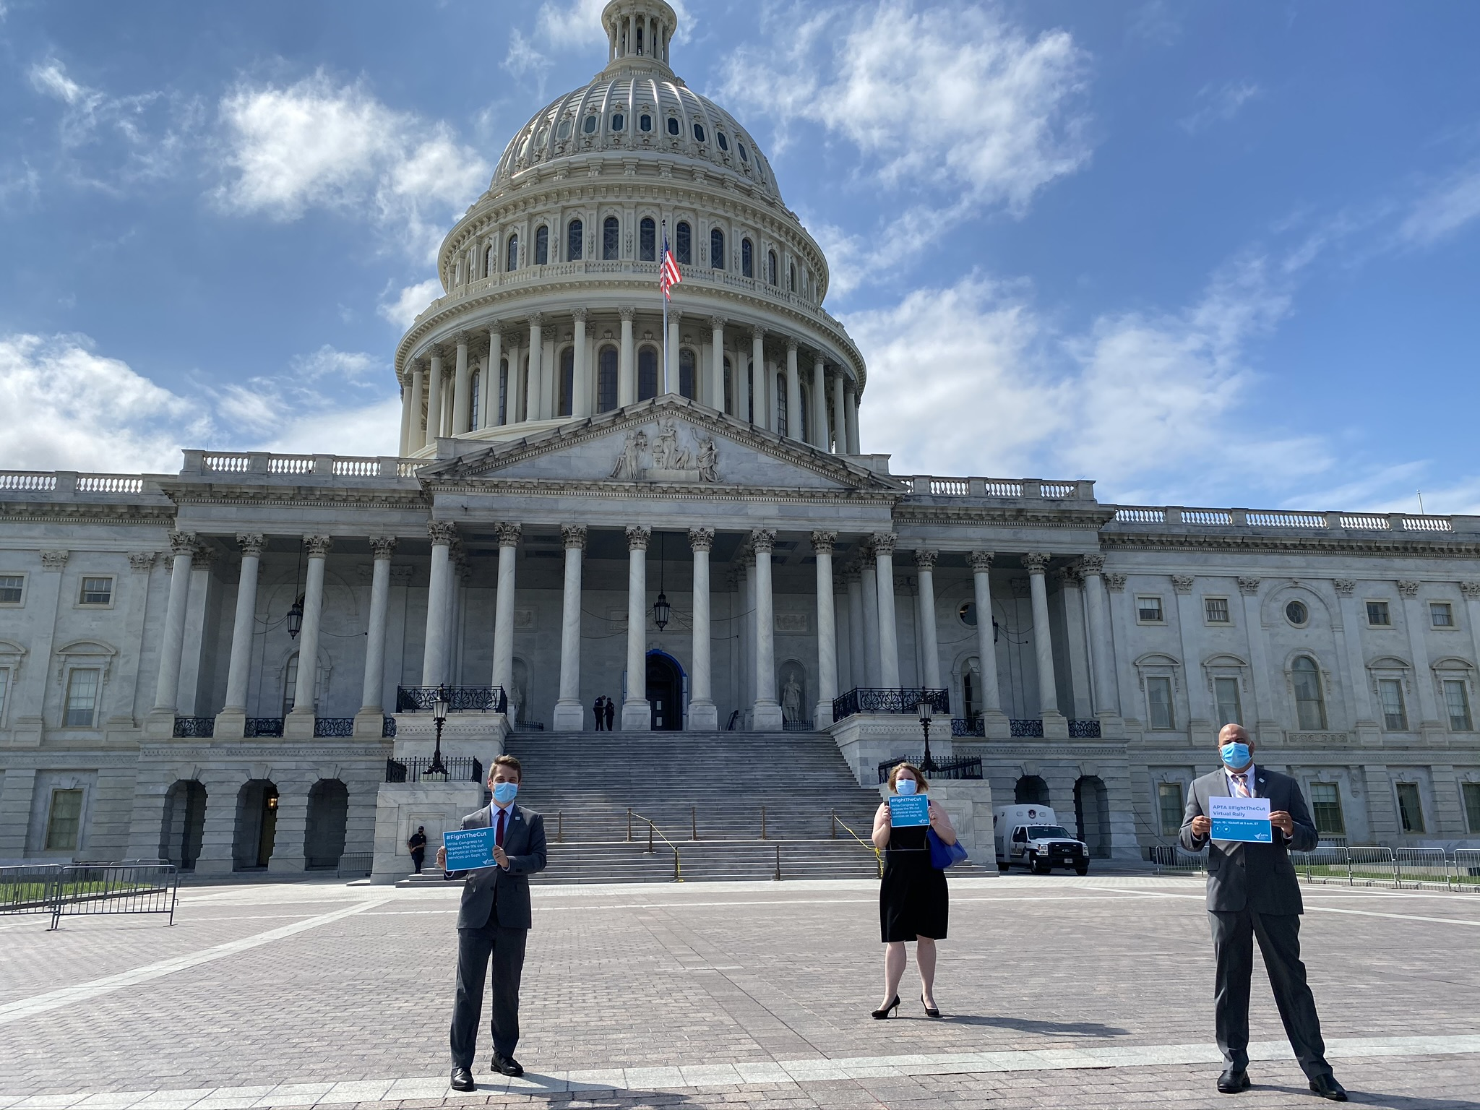
Medicare Cuts
Medicare Physician Fee Schedule
Fight any cuts and find alternatives to the payment model
Notes:
APTA continues to fight any and all cuts to payment, including to Medicare.
Medicare-enrolled PT private practices and outpatient facility-based therapy providers are reimbursed by the Centers for Medicare and Medicaid Services, or CMS, under the Medicare Physician Fee Schedule (MPFS) on a fee-for-service basis. This payment system must be, by law, budget neutral. Annually, CMS releases the MPFS, which may include payment cuts (or increases) to various practice areas in order to maintain budget neutrality.
Why should students care about Medicare? Many of your future patients may be on Medicare. Private insurers often use Medicare as a model when determining their payment rates, so any cuts Medicare makes may be adopted by private insurance.
TRANSITION: APTA works on bills that impact students.

Slide 10
Students
National Health Service Corps
Physical Therapist Workforce and Patient Access Act (H.R. 3759/S. 2676)
Allow PTs to participate in student NHSC student loan repayment program
Serve in rural/underserved areas for two years
Help combat the opioid crisis and bring care to areas that need it
Workforce Diversity
Allied Health Workforce Diversity Act (H.R. 3320/S. 1679)
Increase opportunities for individuals from underrepresented backgrounds
Scholarship opportunities and expansion of mentorship programs
Notes:
Among others, APTA has two signature issues that impact students.
National Health Service Corps: The National Health Service Corps Loan Repayment Program is a program that places medical professionals in areas of the country that need them the most, while paying student loans for qualified individuals. In exchange for working two years in a rural or underserved areas, providers can earn up to $50,000 in loan repayment. Adding physical therapists to the NHSC will ensure that patients in rural and underserved areas have access to nonpharmacological options for the prevention, treatment, and management of pain. This bill would help fight the opioid epidemic; physical therapy is an essential component to alter the trajectory of the current crisis.
Workforce Diversity: This legislation would increase opportunities for individuals from underrepresented and disadvantaged backgrounds, including those from racial and ethnic minorities, in the professions of physical therapy, occupational therapy, speech language therapy, and audiology. This bill allows higher education programs for these professions to strengthen and increase the recruitment, enrollment, retention, and graduation of students from underrepresented and disadvantaged backgrounds. These strategies include community outreach, the creation or expansion of mentorship and tutoring programs, and providing scholarships and stipends to students.
Visit the APTA Legislative Action Center and Patient Action Center to send letters to your members of Congress and tell you story of how this legislation would impact you and your future.
TRANSITION: What are other issues APTA works on?

Slide 11
Additional Priority Legislation
Current Legislation
Locum Tenens (H.R. 1611/S. 2612)
Medicare Opt Out (H.R. 3322/S. 826)
Lymphedema (H.R. 3630/S. 1315)
Prior Authorization (H.R. 3173)
Community Health Centers (H.R. 5365)
And more!
Notes:
As mentioned before, APTA works on many issues that impact the physical therapy profession, with an emphasis on the many! Two recent bills that were introduced are locum tenens and Medicare opt-out legislation.
Locum tenens is the term for a system in place under Medicare that allows a physical therapist to bring in another licensed PT to treat Medicare patients and bill Medicare through the practice provider number during temporary absences. However, there are limits on who can use the system. H.R. 1611/S. 2612, the Prevent Interruptions in Physical Therapy Act, would expand locum tenens to all PTs and PTAs nationwide. Continuity of care is important, particularly in physical therapy. Patients shouldn't have to have their care interrupted, and PTs shouldn't be forced to suspend services during temporary absences for illness, pregnancy, vacation, or continuing medical education.
The Medicare Patient Empowerment Act (3322/S. 826) is legislation that would permit physical therapists to privately contract with Medicare beneficiaries. Patient access to physical therapist services would be increased by eliminating unnecessary regulatory, legal, and payment policy barriers. By allowing physical therapists to “opt out” of the Medicare program and privately contract with Medicare beneficiaries, many would be empowered to select the health professional of their choice.
Lymphedema: APTA is part of the coalition supporting the Lymphedema Treatment Act (H.R. 3630/S. 1315). This bill will improve coverage for the treatment of lymphedema from any cause by amending Medicare statute to allow for coverage of compression supplies.
Community Health Centers: The Primary Health Services Enhancement Act (H.R. 5365) is bipartisan legislation would increase patient access to essential physical therapy services to children and adults who receive care at rural health clinics and federally qualified health centers, also known as community health centers (CHCs).
Prior Authorization: Many APTA members report that medically necessary physical therapist services are delayed, greatly impacting patients’ clinical outcomes, because of the amount of time and resources they spend on documentation and administrative tasks. The Improving Seniors’ Timely Access to Care Act is bipartisan legislation would streamline the prior authorization process.
Concussions: This legislation encourages the development of concussion management guidelines that will strengthen the procedures involving the prevention, identification, and treatment of concussions in elementary and secondary schools.
This is just a small sample of the issues APTA works on. Please visit apta.org/advocacy to learn more and raise your voice with your legislators.
TRANSITION: How can you get started and get involved?

Slide 12
Getting Involved
Notes:
However you choose to participate in advocacy, APTA has a place for you. Before you get started, it’s important to know that advocacy is a marathon, not a sprint. Advocacy can often take a long time and we must be persistent, patient, and persuasive.
TRANSITION: What advocacy programs does APTA have?

Slide 13
Student Involvement All Year
Student Advocacy Challenge
Programs compete against each other by participating in advocacy activities
Submit activities for credit through APTA website or APTA Advocacy App
Flash Action Strategy
Two-day, student-led social media blitz
Focused around an issue impactful to students
Raise awareness with legislators
September 2022
Notes:
Besides the National Advocacy Dinner that you are taking part in right now, APTA has other student programs.
The Student Advocacy Challenge is a competition among PT and PTA programs to participate in advocacy activities for points. On the Student Advocacy Challenge website, there is a menu of activities that you can complete for points. You can submit your activities for credit through the APTA website or APTA Advocacy App.
The Challenge runs from January 2022-end of December 2022. The winning program will not only get bragging rights, but featured on APTA’s website and will receive a virtual or in-person presentation by an APTA staff or Board member of the program’s choice.
In the fall, students rally around an issue impactful to them and their future by participating in Flash Action Strategy. Flash Action Strategy is a two-day, student-led social media blitz that includes connecting with your legislators on social media and sending letters to your members of Congress. In the past few years, students participating in FAS have been responsible for over 81,000 letters going to Congress. It’s as easy as sending a tweet to participate, and with the collective action of all students, we can make a big difference!
Be on the lookout for more information over the summer and the 2022 Flash Action Strategy will be sometime in September.
Transition: What kind of advocacy programs are available to participate in throughout your career?

Slide 14
APTA Grassroots Program Structure
APTA Advocacy Network
Key Contact
Federal Affairs Liaison
Notes:
APTA has a structured grassroots program to amplify the voice of the profession, build relationships with lawmakers, and show our collective power.
The first, easiest way to get involved is to join the APTA Advocacy Network. This is APTA’s strength in numbers. Network members receive periodic action alerts, which asks for support on an issue by sending a letter to your members of Congress. By sending thousands of letters to Capitol Hill on a particular topic, this shows support and helps to educate and inform lawmakers. It takes minimal time to be a part of the APTA Advocacy Network but makes a huge impact; to send a letter to Congress takes about 3 minutes. APTA Advocacy Network members also receive Information Bulletins, which are breaking news updates, and a newsletter.
APTA has two places to take action and send letters to Congress. The first is the Legislative Action Center, open to APTA members only, and the second is the public Patient Action Center. APTA Advocacy Network members are encouraged to ask fellow APTA members to join the network, and ask friends, family, colleagues, etc. to participate by sending letters of their own through the Patient Action Center.
Next in the grassroots structure is the Key Contact program. Key Contacts serve as the liaison between a member of Congress and APTA. We rely on Key Contacts to reach out to their member of Congress when we need their support for legislation, sign-on letters, briefings, and more as well as educate them on the physical therapy profession. Key Contacts are encouraged to get to know the staff of their legislator, especially the health legislative assistant, and periodically contact them. We’ll discuss more about the Key Contact role in the next slide.
Finally, the Federal Affairs Liaisons, or FALs, are the state/component advocacy leads. This appointed position informs their grassroots membership and components on advocacy updates and helps identify Key Contacts. They also assist in coordinating August Recess activities and other in-district visits throughout the year, attend PTPAC fundraisers, and help recruit other APTA members for advocacy participation.

Slide 15
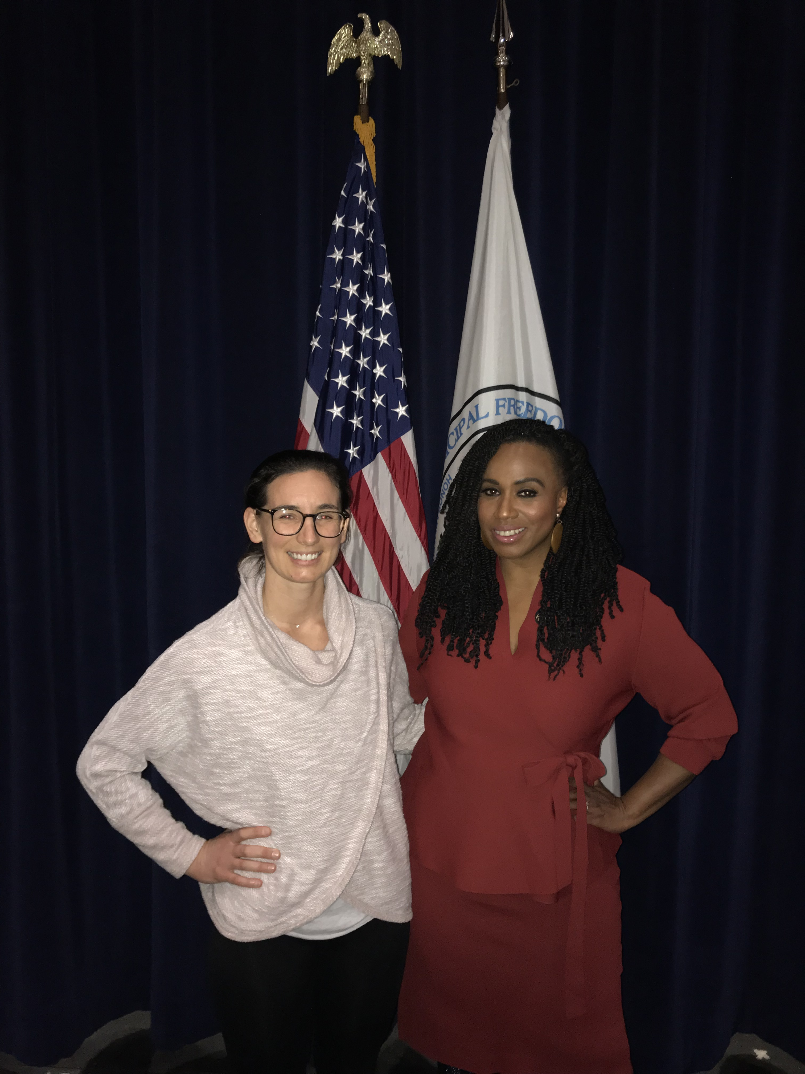
Key Contacts
Form and build relationships with members of Congress and their staff
One or two for each Congressional district
One to three for Senate
Periodically reach out to legislators and their staff
Sign on letters and sharing your personal story
Virtual and in-person meetings and site visits
Meet during August Recess
Notes:
Key Contacts are important in furthering physical therapy advocacy because they are the link between legislators and APTA, and serve as a resource on PT to the member of Congress. Key Contacts must reside or have a business in their member of Congress’ district. There may be multiple Key Contacts in a district, and usually there are even more for Senators, who represent the whole state.
Key Contacts establish these vital connections by introducing themselves to their member of Congress and their staff. Getting to know the staff in charge of health care is critical because they have the ear of the legislator on health issues and often advise the legislator on whether or not to support a particular bill. It may be tough to get started, but that’s okay! Just remember that the first step is often the hardest and remember that members of Congress WANT to hear from you, their constituent. Many members of Congress ran for office to make a positive impact for their home and district.
Key Contacts are also expected to set up August Recess visits with their member of Congress. In June, Key Contacts are provided talking points, information to give to legislative staff, tips, and guides to help you have a successful August Recess.
Key Contacts can also attend town hall meetings and talk about physical therapy issues. Town halls can be by phone, virtually, on social media, or in person. To find out about these events, follow your members of Congress on social media and/or sign up for their newsletter.
Key Contacts are encouraged to connect with their legislators through social media. Most members of Congress have social media handles and have staff that monitor trending issues. You can post about PT issues, include photos, and tag your legislator so they see it. Social media is a powerful, easy, and impactful advocacy tool.
Building the relationship between Key Contact and legislator and their staff means reaching out to members of Congress and their staff by periodic contact, updates, and face to face meetings. It’s important for Key Contacts to let APTA know what outreach you’ve made and any feedback you receive from legislative staff. APTA lobbyists are working on Capitol Hill and having information on the contact by APTA members can only strengthen our collective efforts. Overall, the program doesn’t require much of your time, though meetings can take around 20-30 minutes and other outreach can take upwards of 10 minutes.
Transition: What can you do right now to get started?

Slide 16
Ways to Get Involved
APTA Advocacy App
Invite member of Congress to tour your school and/or meet with students
Become a Key Contact
Ask your friends and family to send letters to Congress through Patient Action Center
Support PTPAC by becoming a Student Star ($20)
Notes:
As you continue in your career, you are encouraged to continue to advocate. APTA makes it easy to take action. Take your first steps as an advocate:
Sign up to the APTA Advocacy Network, if you haven’t already.
Download the APTA Advocacy App. You can sign up for the Network there, send letters to your members of Congress, look up your members of Congress and see what bills they support, and learn about our policy issues. The app makes it easy to advocate from anywhere.
Ask your legislators to tour your school or organize a group of students to visit with a legislator (in-person or virtually!).
Become a Key Contact. Reach out at advocacy@apta.org or find the opportunity through APTA Engage.
Encourage your friends and family to send letters to their members of Congress by sharing the Patient Action Center link with them.
Support PTPAC by becoming a Student Star ($20)
Remember, you are a vital part of APTA’s advocacy structure because you’re the constituent and you’re the expert! Your unique experience in the physical therapy profession is important and members of Congress need to hear it.
Transition: How does PTPAC support your voice with Legislators?

Slide 17
What is PTPAC? How does PTPAC help the profession?
PTPAC is the political action committee of APTA
Raises money from APTA members
Provides contributions to members of Congress or candidates who are friendly to the profession
Provides opportunities to speak to members of Congress
Support PTPAC
$20 Student Star program
$60 Coffee Club for early professionals (0-5 years out of school)
Notes:
PTPAC is the political action committee of APTA and relies on voluntary donations from APTA members, not member dues, to have our voice heard in Congress. By attending fundraisers, APTA staff and members have important facetime with legislators to discuss issues important to the profession. How does PTPAC help the profession?
Supports PT friendly members of Congress in their election campaigns
Provides opportunities to talk to members of Congress at fundraisers about the issues of concern to the profession
Builds relationships with members of Congress and staff through fundraisers that APTA staff and members can attend
As a student, you can support PTPAC by donating $20 and becoming a Student Star.
Early professionals, which are those 0-5 years out of school, are eligible to become a member of the Coffee Club. This club, which is $60 a year, or the cost of a cup of coffee a month, is where members receive invitations to exclusive webinars with special guest speakers, exclusive gatherings at APTA events, mentorship and networking opportunities, and recognition on the PTPAC website.
Transition: Are you ready to begin your advocacy journey? Are you ready to make an impact for the physical therapy profession?

Slide 18
Questions & Answers
advocacy@apta.org
Notes:
If you have any questions or want to reach out to APTA advocacy staff, please connect at advocacy@apta.org.

Slide 19
Thank You
Notes:
Thank you for attending the 2022 National Advocacy Dinner! Remember, if we’re not at the table, we’re on the menu. Our collective and persistent efforts will pay off for the future of the physical therapy profession. Always remember that your voice matters and makes a difference. We look forward to your participation in APTA advocacy programs.

