Slide 1
Exporting Data from CPI Web

Slide 2
Exporting Data
General Overview
Exports for all the data below can be extracted with or without CSIF enabled for your program.
However, if CSIF is not enabled and should be, contact customer service for assistance. Contact us by phone at 857-304-2045 or by email at aptaclinicalsupport@liaisonedu.com
Data can be extracted for:
Clinic sites.
Academic programs.
Students.

Slide 3
Exporting Clinic Site Profile Data
Open the Sites tab and click Export APTA Clinical Site Profile Results.

Slide 4
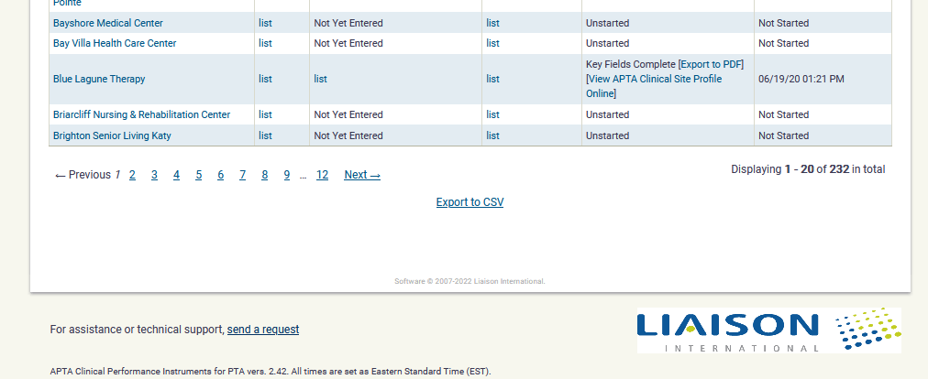
Exporting Clinic Site Profile Data
Scroll to the bottom of the page and click Export to CSV.

Slide 5
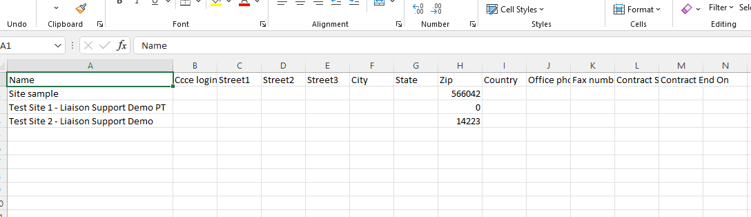
Exporting Clinic Site Profile Data
Example of an Export

Slide 6
Exporting Individual Clinic Site Data to PDF
Open the Sites tab.
Find the clinic Site Name.
Click Export to PDF in the APTA Clinical Site Profile Completion Status column.

Slide 7
Exporting CI/SCCE Data
Open the SCCE/CI tab.
Scroll to the bottom of the page and click Export to CSV.

Slide 8
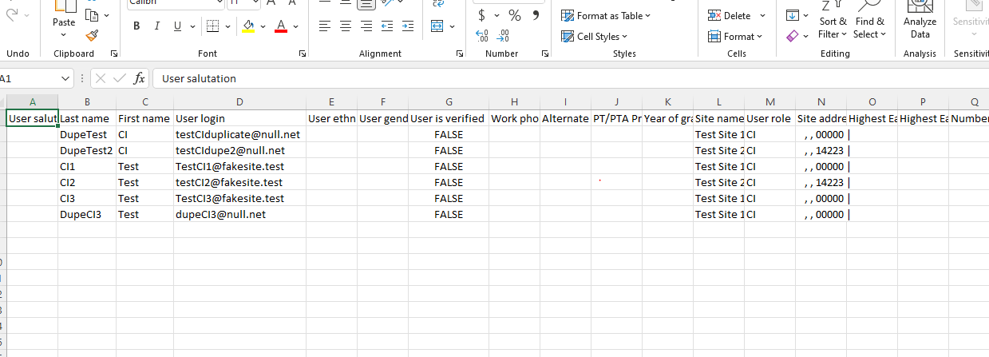
Exporting CI/SCCE Data
Example of an Export
This report includes the name, user role, email address, and SCCE/CI training status at the time of export.

Slide 9
Exporting Student Evaluation Data
Open the Evaluations tab.
Click Export Evaluation Results.

Slide 10
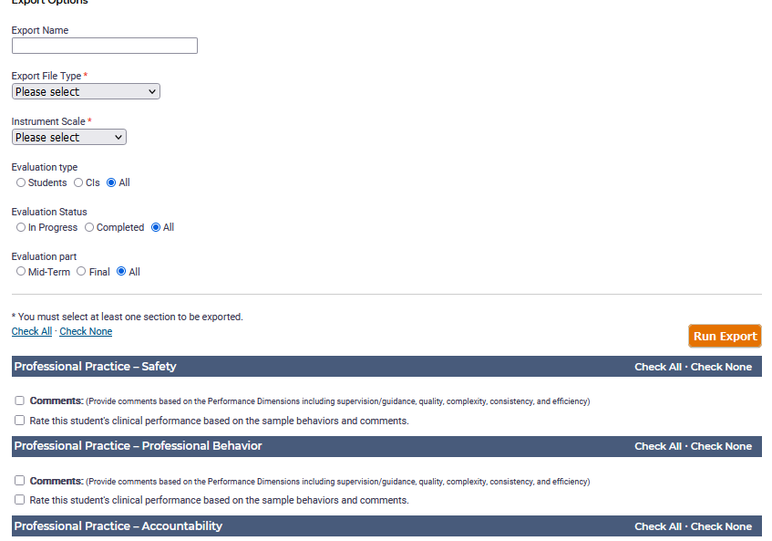
Exporting Student Evaluation Data
Select the evaluation(s) you want to export and the information you want included. You can choose to export every section from the evaluation and include the ratings and/or comments.

Slide 11
Exporting Student Evaluation Data
Note the following:
For the Export File Type, there are two different file extensions:
.csv (comma-separated values), where the data is in text format separated by commas.
.xls (Excel), where the data is placed in rows and columns.
You can view the Instrument Scale Key here: https://help.liaisonedu.com/APTA_Clinical_Assessment_Help_Center/APTA_Clinical_Performance_Instruments/PTA/ACCE_DCE_Program_Staff/04_Exporting_Evaluation_Results

Slide 12
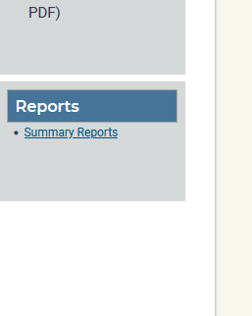
Exporting other data/developing custom reports
Open the Reports tab and click Summary Reports. This feature is used to gather broad information for your desired group, which can be all student data, clinical site profile data, or site data. For example, if you run a summary report on Student Experiences by PT Instrument Rating Report, this will give you data on every student’s progress now (X number of students are Intermediate, X number are advanced Intermediate etc…).

Slide 13
Exporting Evaluation Set-up Data
Open the Eval Setup tab.
Scroll to the bottom of the page and click Export to CSV.

Slide 14
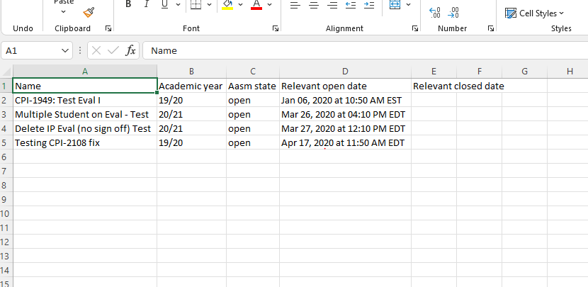
Exporting Evaluation Set-up Data
Example of an Export

Slide 15
Exporting Student Data
Open the Students tab.
Scroll to the bottom of the page and click Export to CSV.

Slide 16
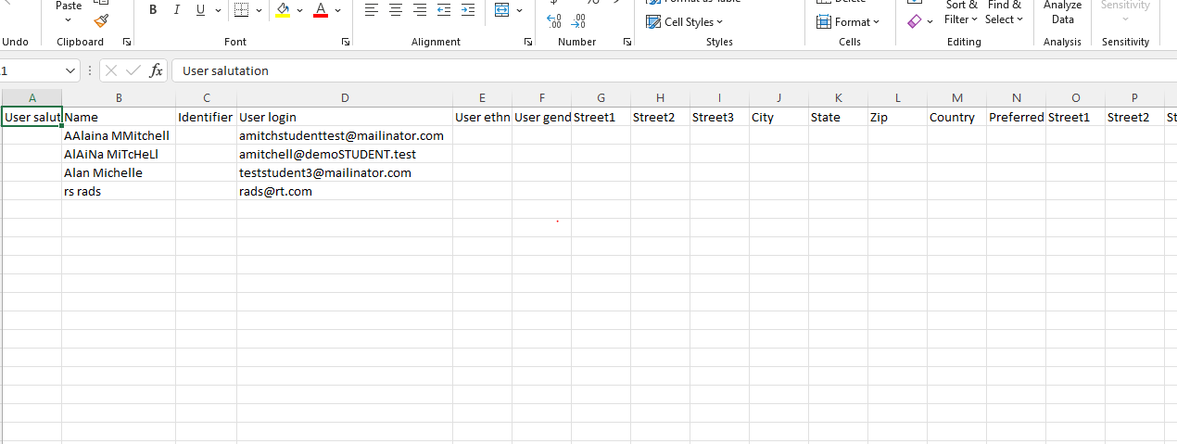
Exporting Student Data
Example of an Export

Slide 17
Thank You

